Slide 1
SDDEC22-12
Creating DNA from scratch for DNA-based data storage
Client: Iowa State University
Advisor: Meng Lu
https://sddec22-12.sd.ece.iastate.edu/#

Slide 2
Team
Connor Larson → Software Engineering
Nathan Armstrong → Electrical Engineering
Lucas Heimer → Electrical Engineering, Minor in Biology
Kyle Riggs → Software Engineering
Brandon Stark → Electrical Engineering
LCD/LED Hardware Development Team → Brandon Stark and Nathan Armstrong
GUI Design Team → Connor Larson and Kyle Riggs
Flow Cell and Controller Design Team → Lucas Heimer

Slide 3
Project Plan
Notes:
KR

Slide 4
Problem Statement:
Perform DNA synthesis
Satisfy a new medium of digital storage
Keep up with increasing demand at an affordable price
Notes:
KR

Slide 5
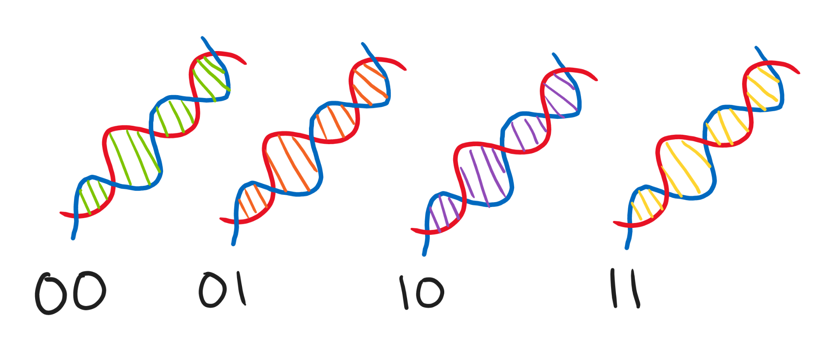
Conceptual Sketch:
Notes:
KR

Slide 6
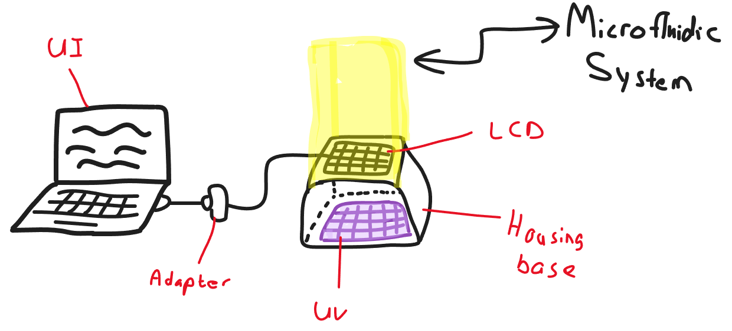
Conceptual Sketch:
Notes:
KR

Slide 7
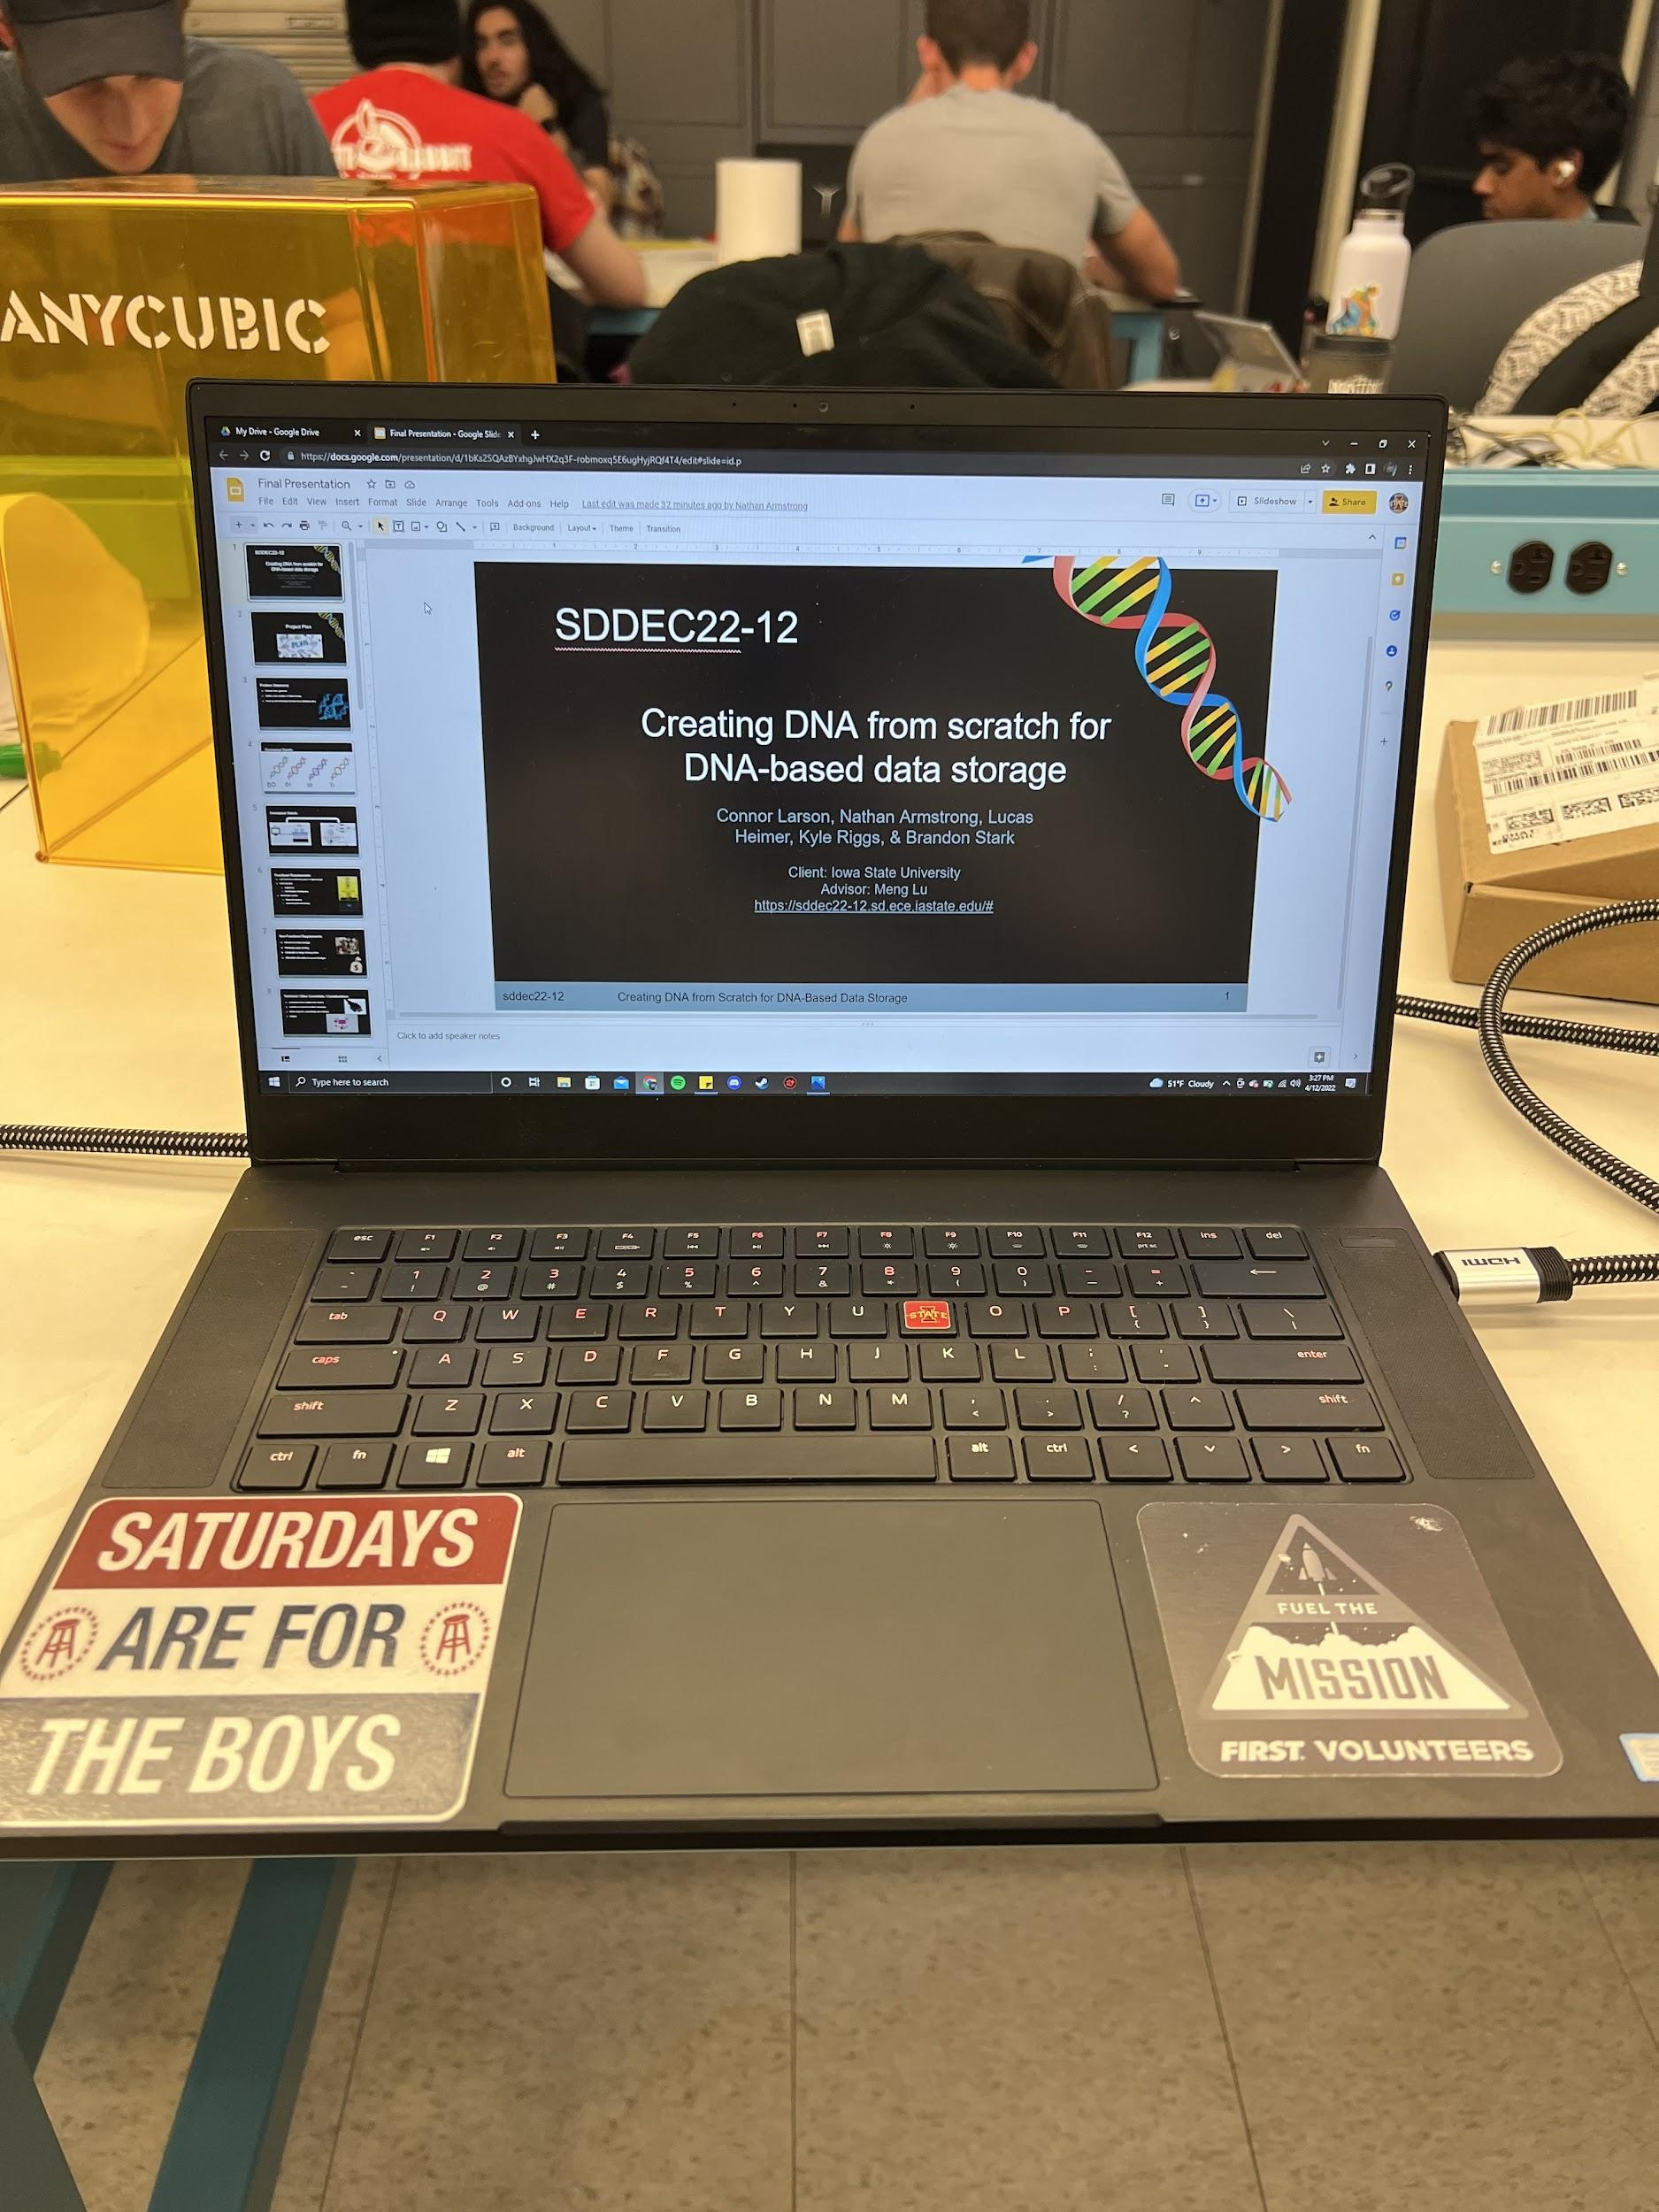
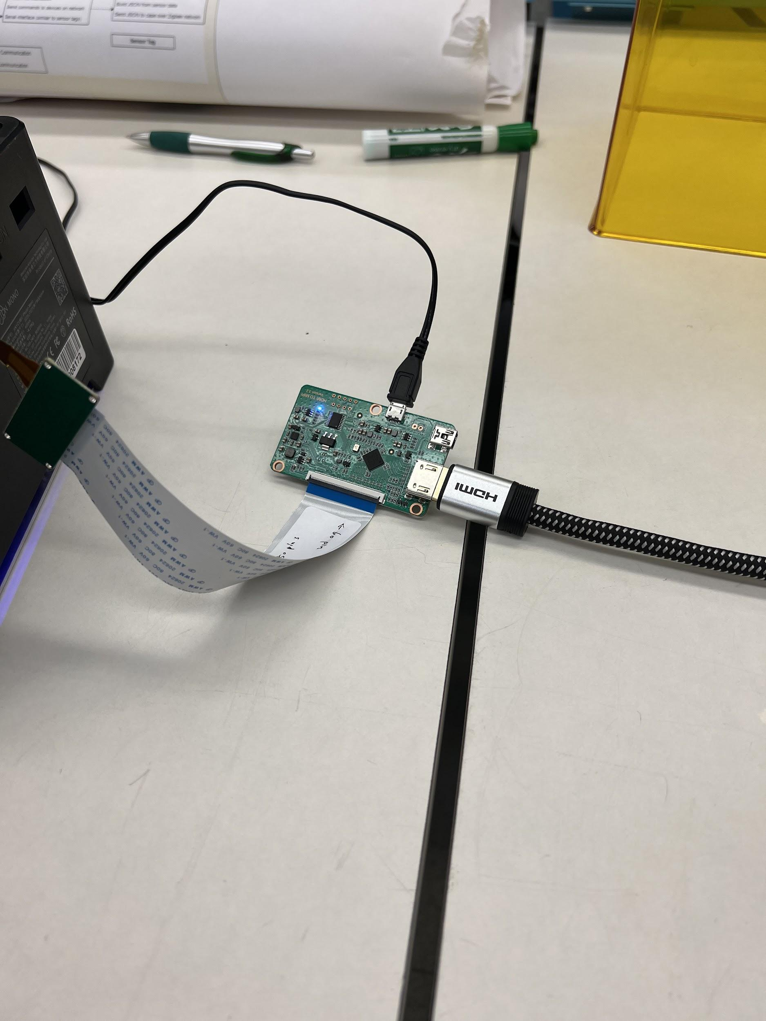
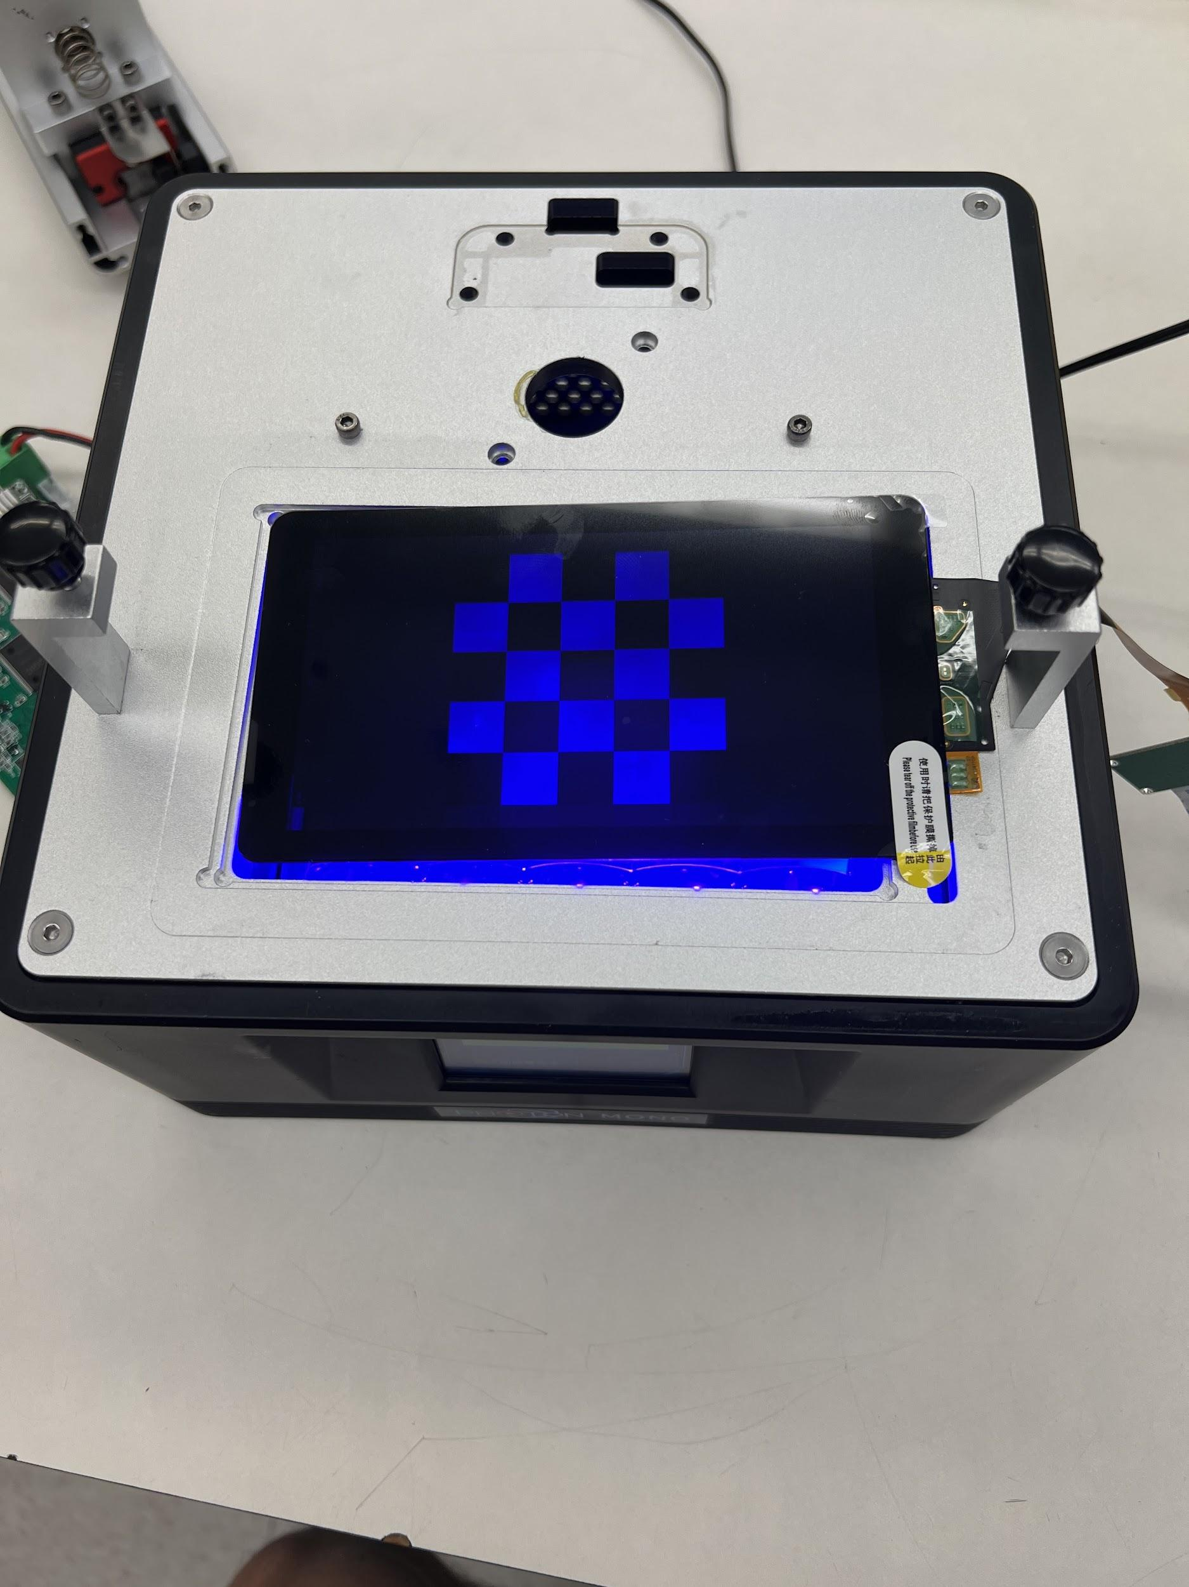
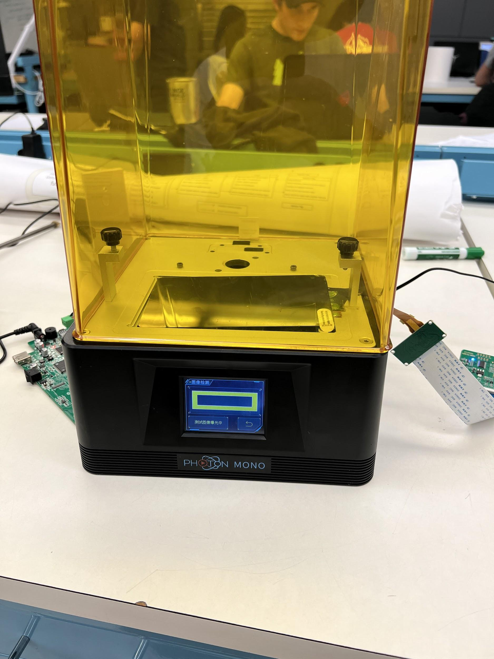

Slide 8
Intended User and Uses:
Users
Geneticists
Investors
Uses
Microarray/ User interface
Digital Data Storage
DNA Synthesis Sequencing
Graphical User Interface

Slide 9
Functional Requirements:
LCD screen to selectively pass UV light through
User interface
Control LCD
Set dimensions of bonding area
Microfluidic system
Initiate DNA synthesis
Autonomously flow all chemicals
Notes:
KR

Slide 10
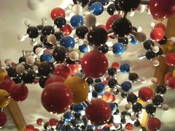
Non-Functional Requirements:
New form of data storage
Relatively quick printing
Adaptable to range of array sizes
Notes:
KR

Slide 11
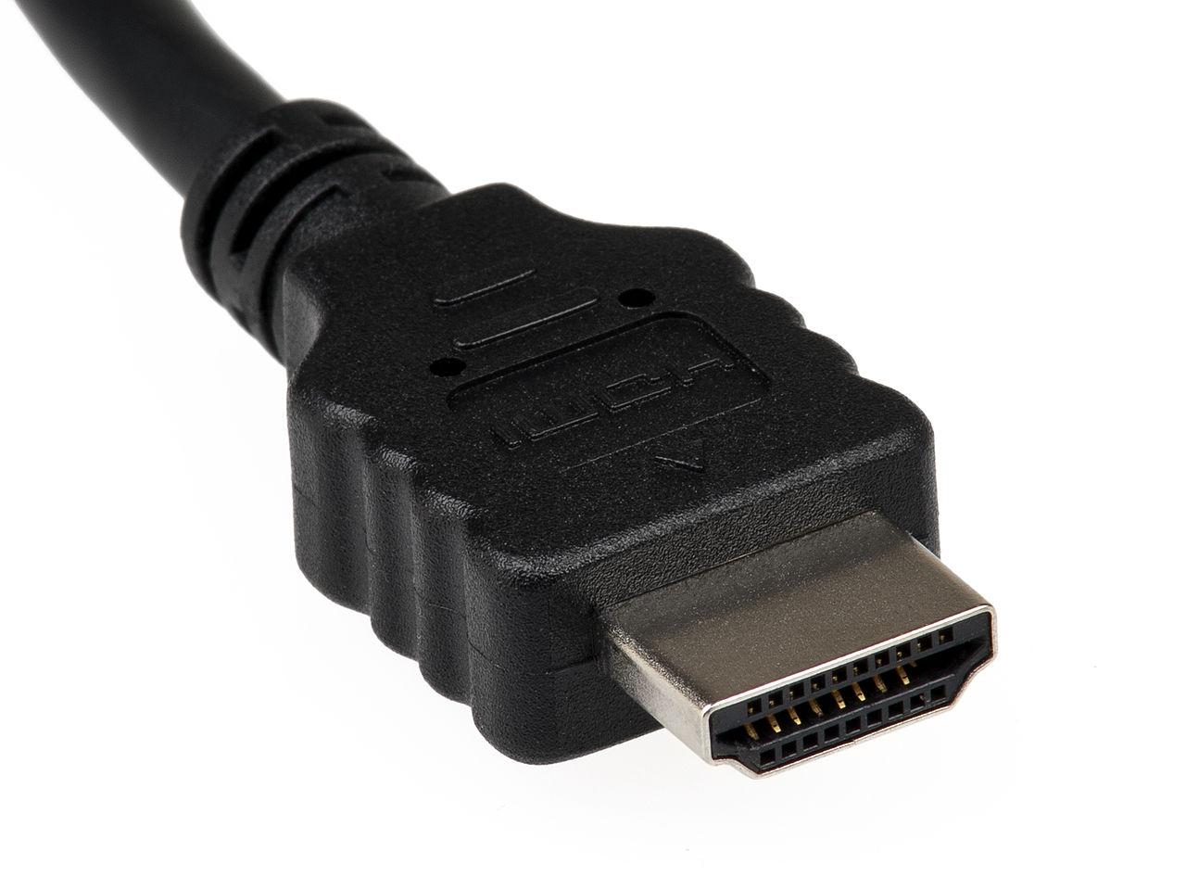
Technical / Other Constraints / Considerations:
Accurately create multiple DNA strands
Control LCD screen via HDMI connection
Make a bug free, user-friendly User Interface
Budget
Notes:
LH

Slide 12
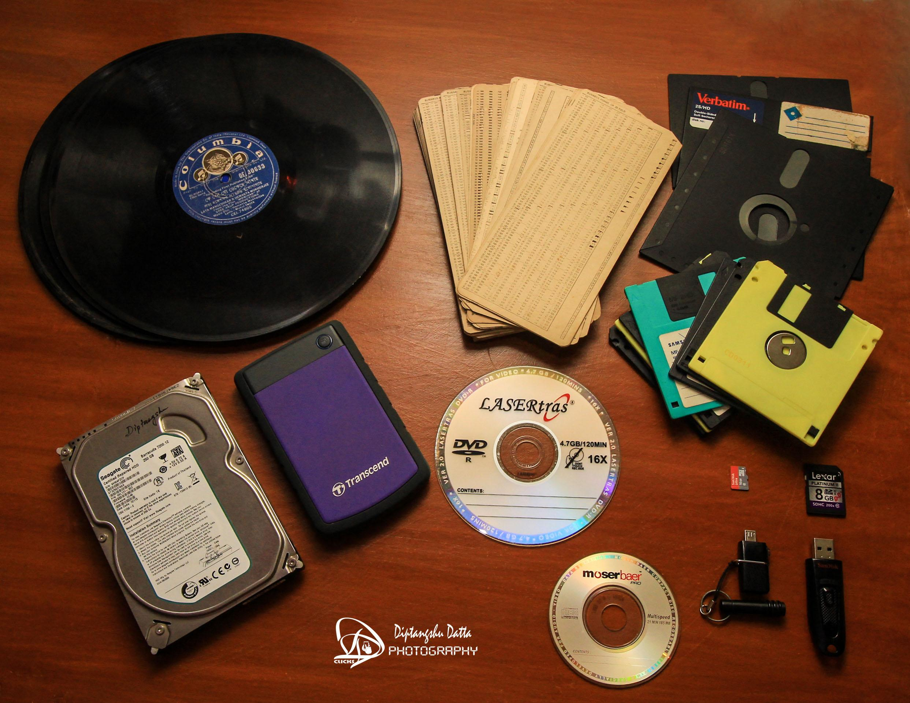
Market Survey (What makes our project unique):
New medium of digital data storage
Use of synthetic biology
Notes:
LH

Slide 13
Potential Risks & Mitigation:
Risks:
Insufficient UV Exposure
Integrity of pressurized tubes
Out of sync clock cycles
General coding of GUI
Inaccurate bonding
Mitigation:
Lengthen Flow cycle
Alternative sealant (PDMS)
Built in delays and resets
Regular debugging
Revisions to cleansing periods or exposure periods
Notes:
LH

Slide 14
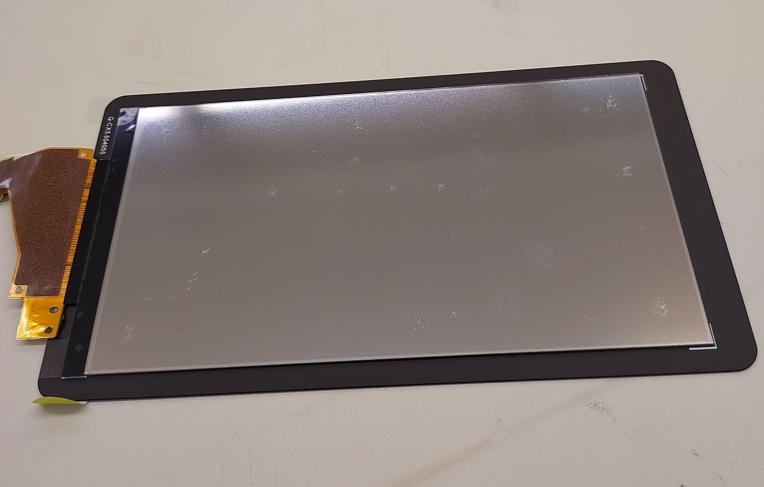
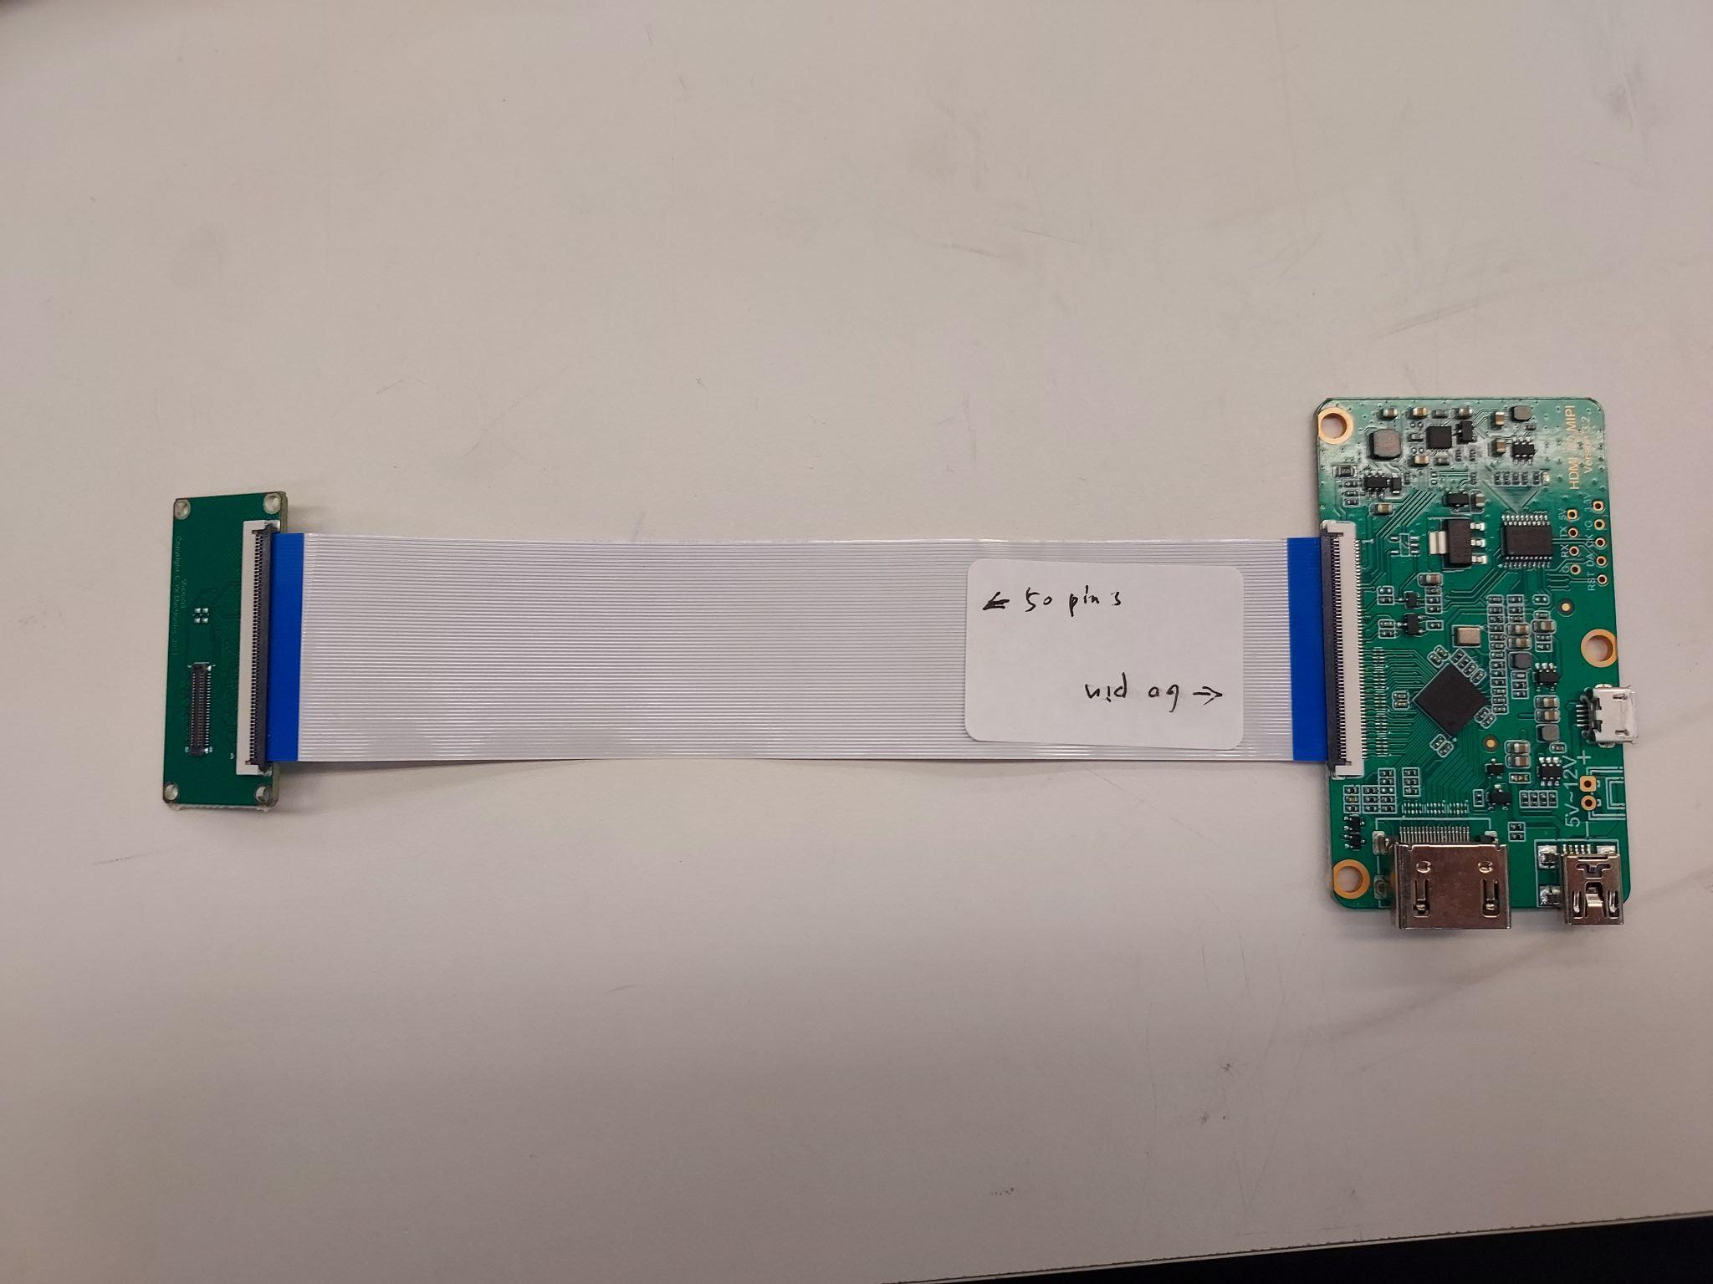
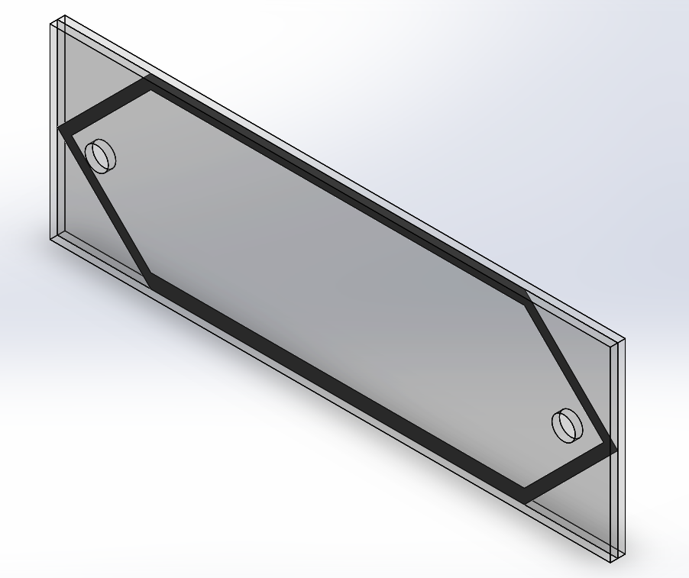
Resource / Cost Estimate:
LCD screen
HDMI to MIPI adapter
Flow cell fabrication
Chemical reagents
Fluigent Components
Notes:
LH

Slide 15
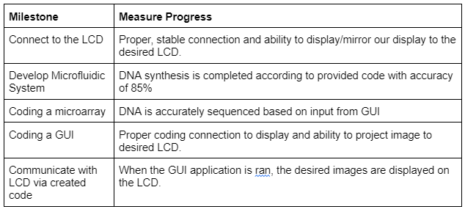
Project Milestones & Schedule:
Notes:
LH

Slide 16
System Design
Notes:
BS

Slide 17
Functional Decomposition:
User Interface:
Dimension Selection
UV Light Control
Image Development
Transmit to LCD
Microfluidic System:
Compressor
Control Valve and Filter
Controllers
M-Switch
Flow Cell
Notes:
BS

Slide 18
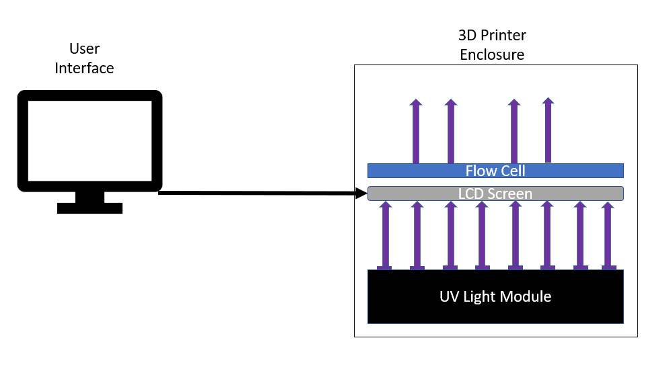
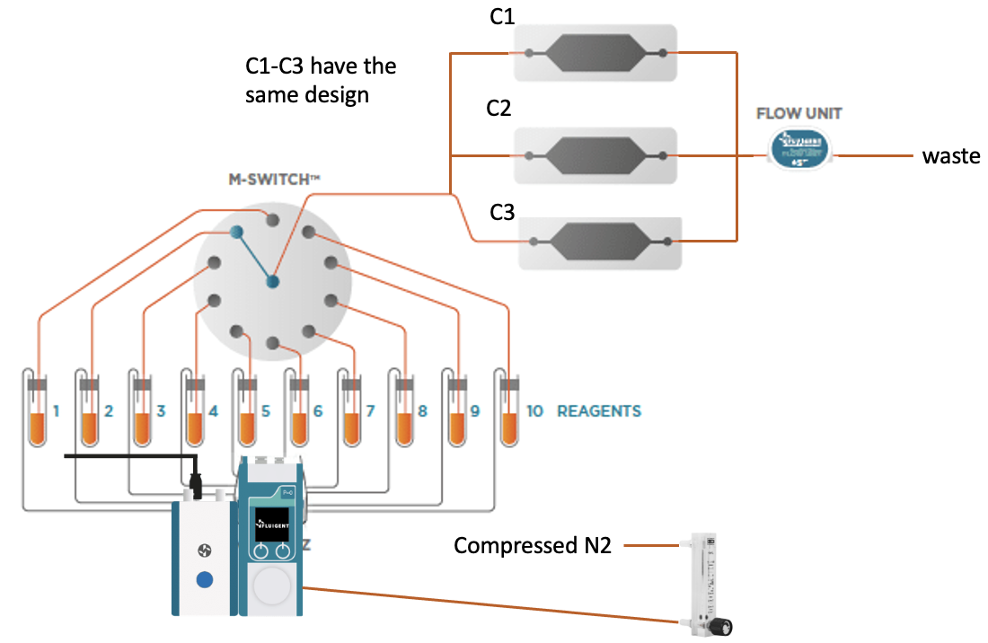
Detailed Design:
Notes:
BS

Slide 19
Technology Platforms Used - Hardware:
LCD Screen
Resolution
UV light
Switch / Control
Notes:
BS

Slide 20
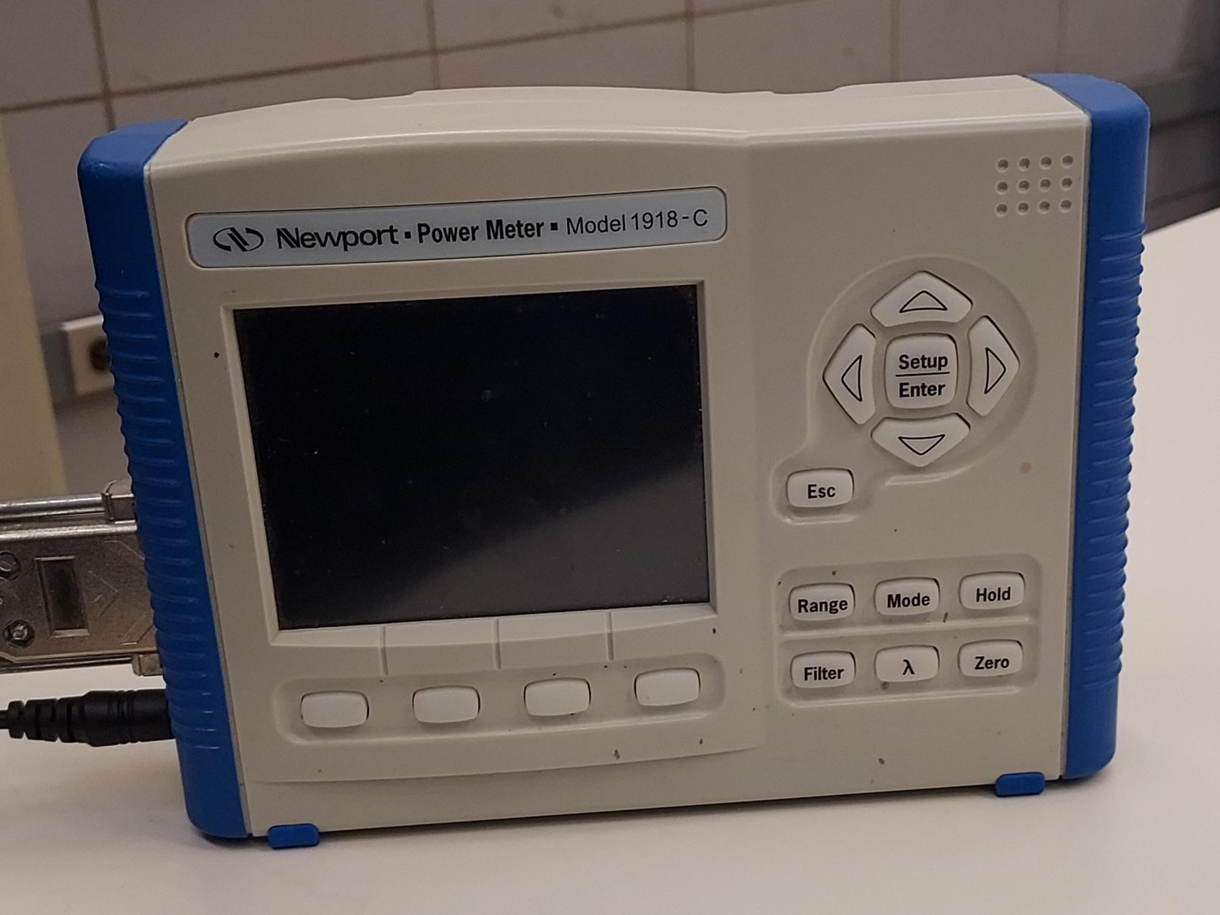
Test Plan - Hardware:
Power meter to measure UV light through LCD
Removal of LCD backing has shown improvement
Large distinction between black and white regions
Flow meter and pressure sensor to monitor microfluidic system
Flow rate closely tied to bonding efficiency
Notes:
BS

Slide 21
Technology Platforms Used - Software:
Windows Presentation Foundation (WPF) Framework
Utilizes:
C#
XAML
Fluigent OxyGEN SDK
Notes:
CL

Slide 22
Test Plan - Software:
Unit Tests that inject different user input to test and see if we get the desired output
Make sure to brainstorm any corner cases
Automation tests for image rendering
Notes:
CL

Slide 23
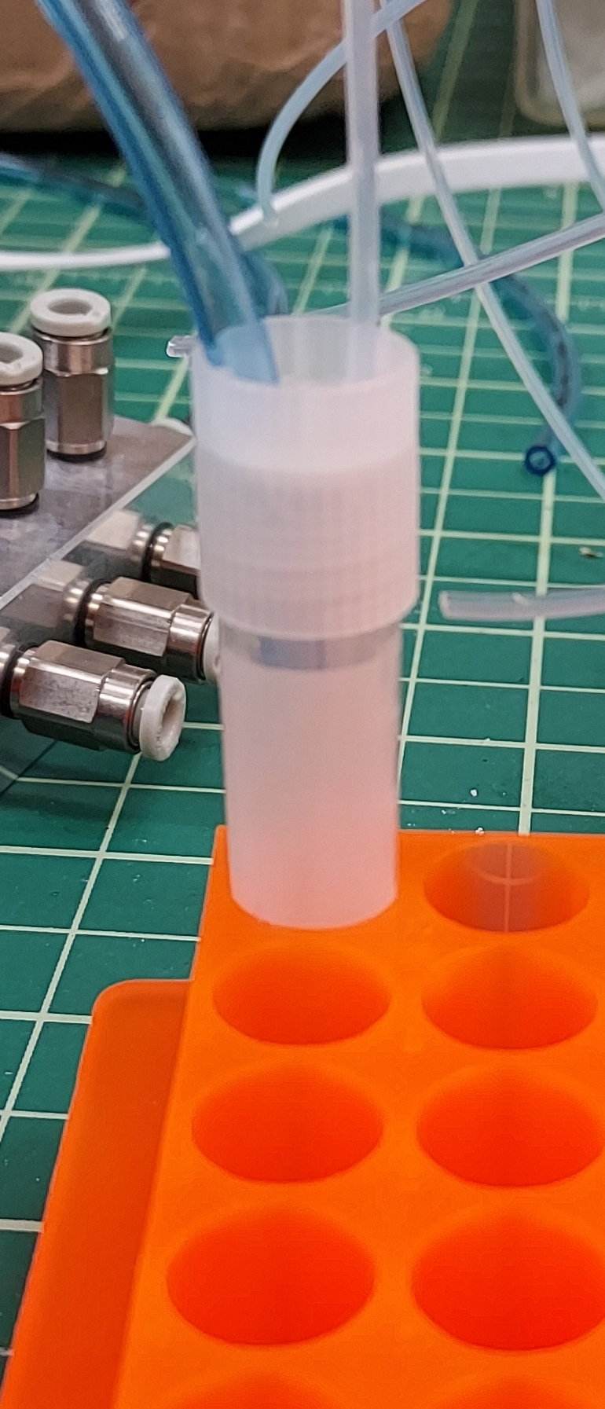
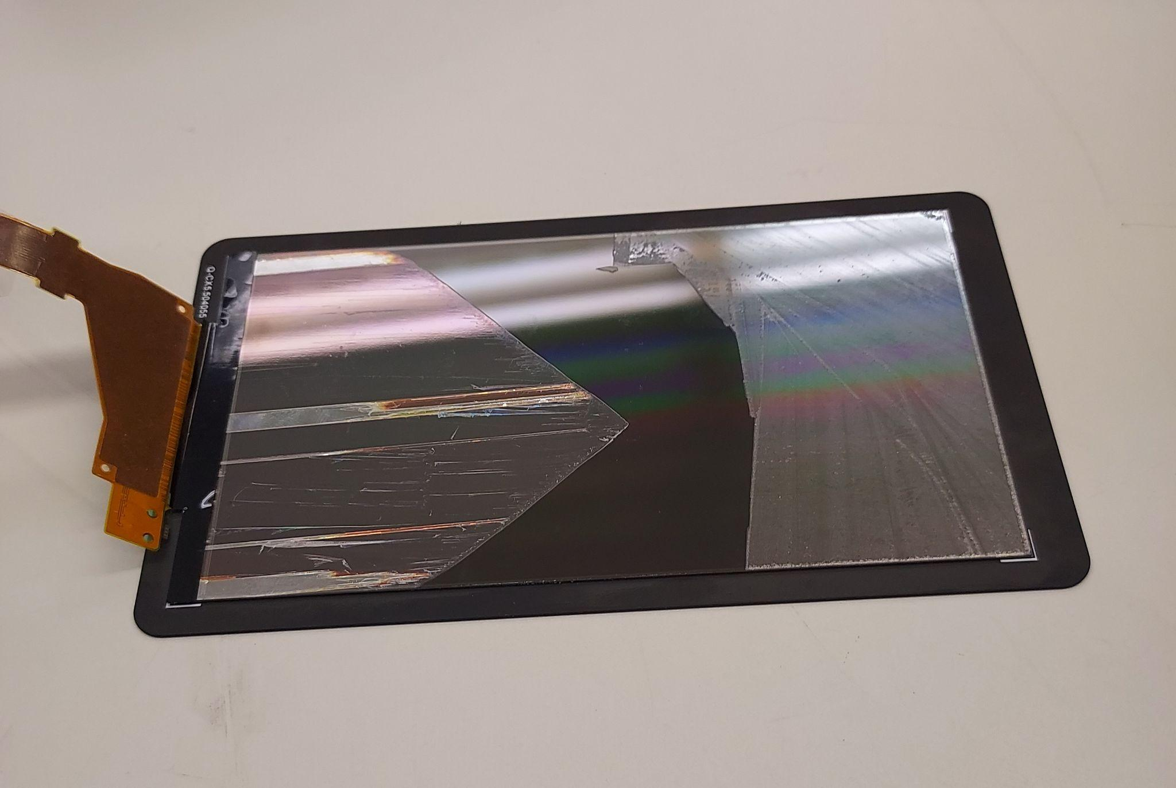
Prototype Implementations:
LCD baseline tests
User interface initial design
Microfluidic System Components (Test Tube and Flow Cell)
Notes:
CL

Slide 24
Conclusion
Notes:
NA

Slide 25
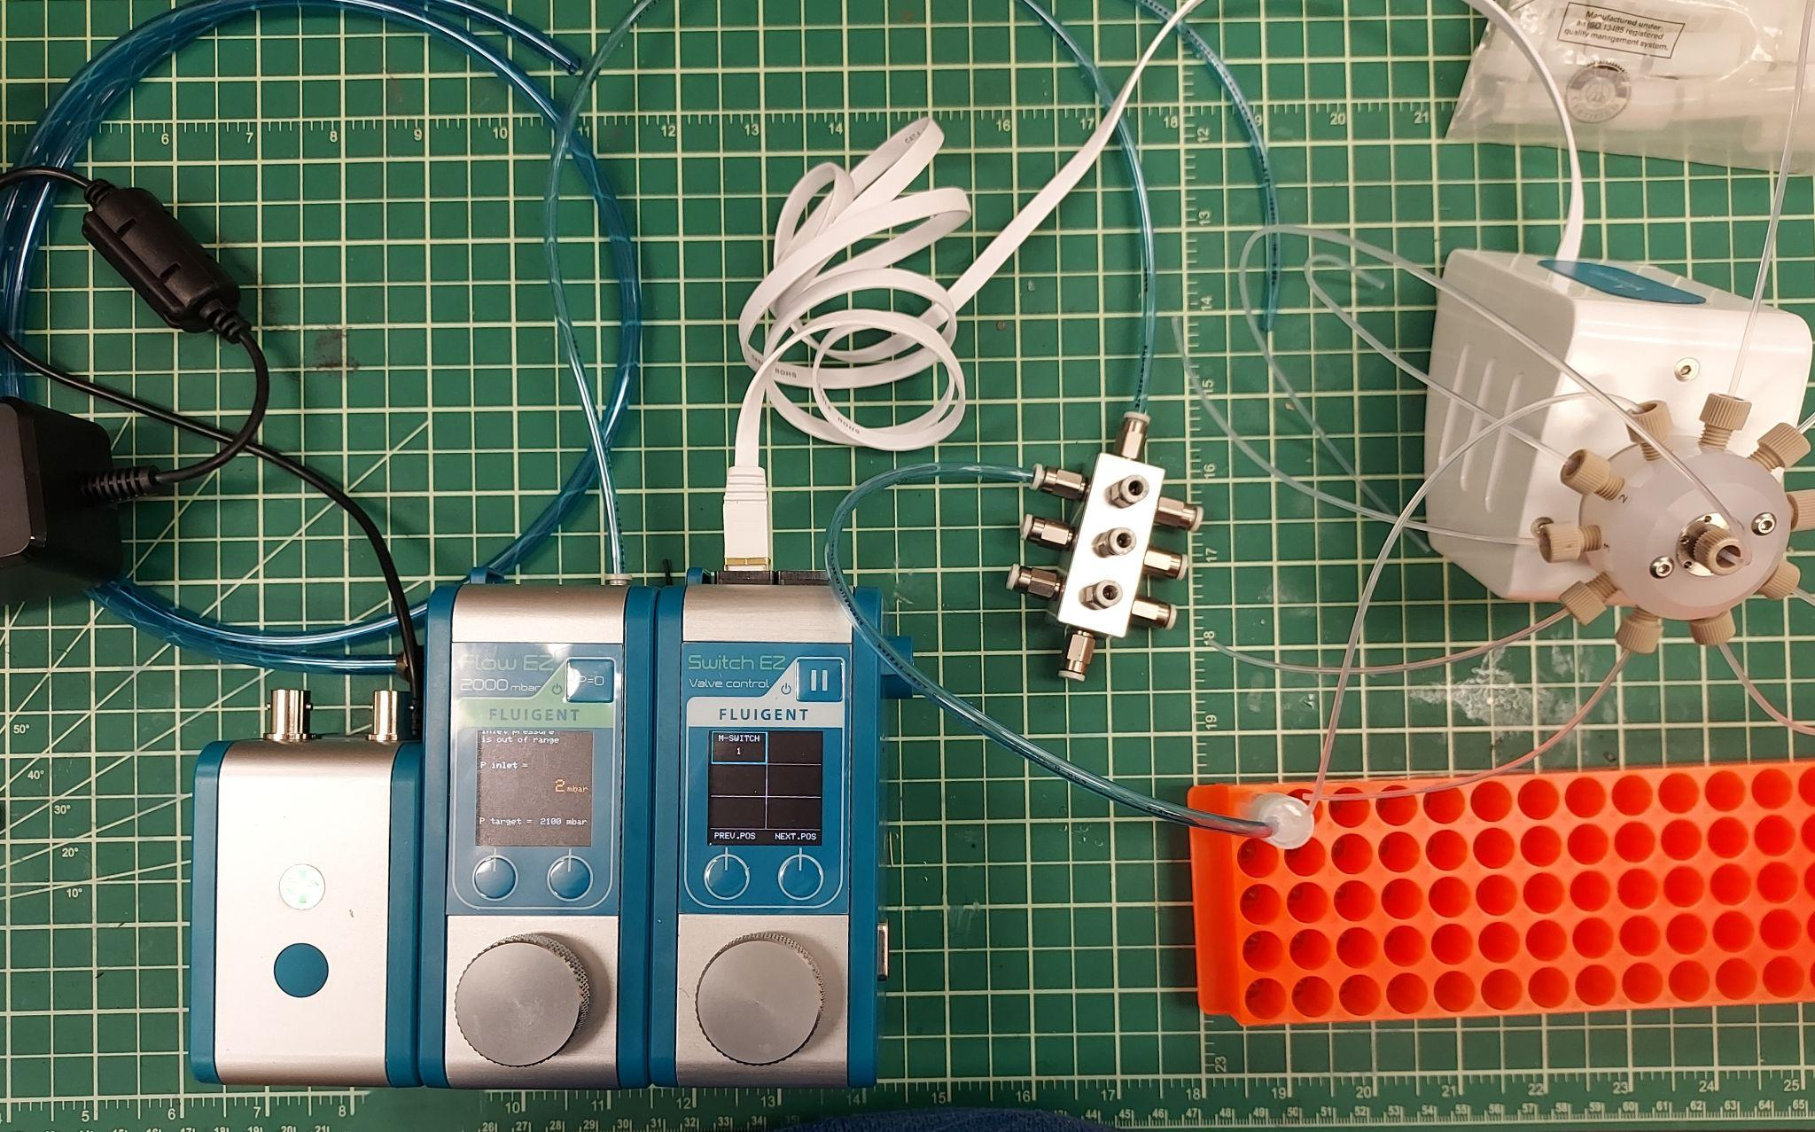
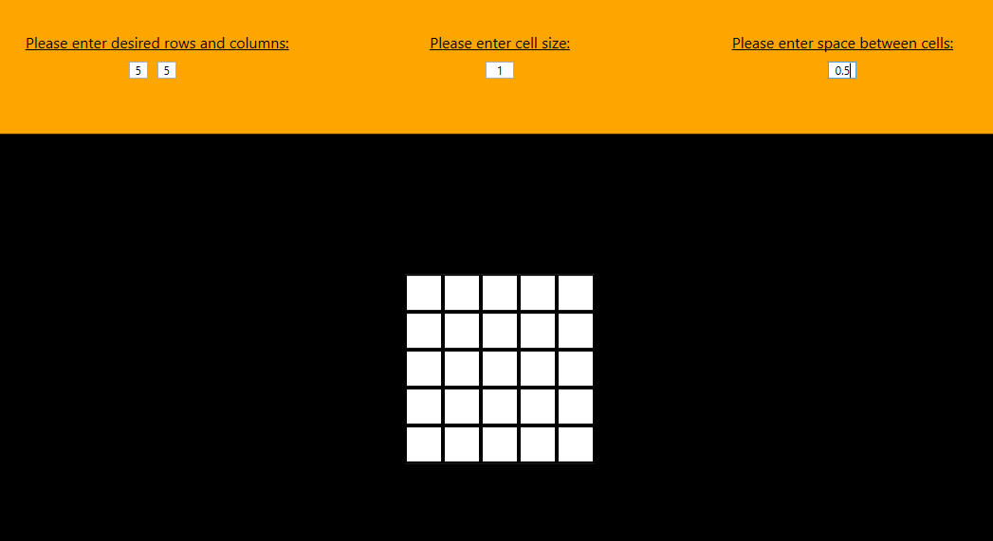
Project Status:
LCD screen
Display connection issues addressed
Testing for improved UV light emission
Microfluidic system
Flow cell design and fabrication
Initial Testing
User interface
Matrix used for printing formulated
User input for matrix customization almost finalized
New window for view sent to LCD started
Notes:
NA

Slide 26
Members Contributions:
Connor Larson and Kyle Riggs: user interface development
Brandon Stark and Nathan Armstrong: LCD screen development
Lucas Heimer: microfluidic system development
All contributed and shared research
Notes:
NA

Slide 27
Next Semester Plan:
Focus on testing of all components
Integration of systems
Improve and validate design
**Sketch for Workflow and reduce image down to just the steps 1→4
Notes:
NA

Slide 28
Questions?
Notes:
NA

