Slide 1
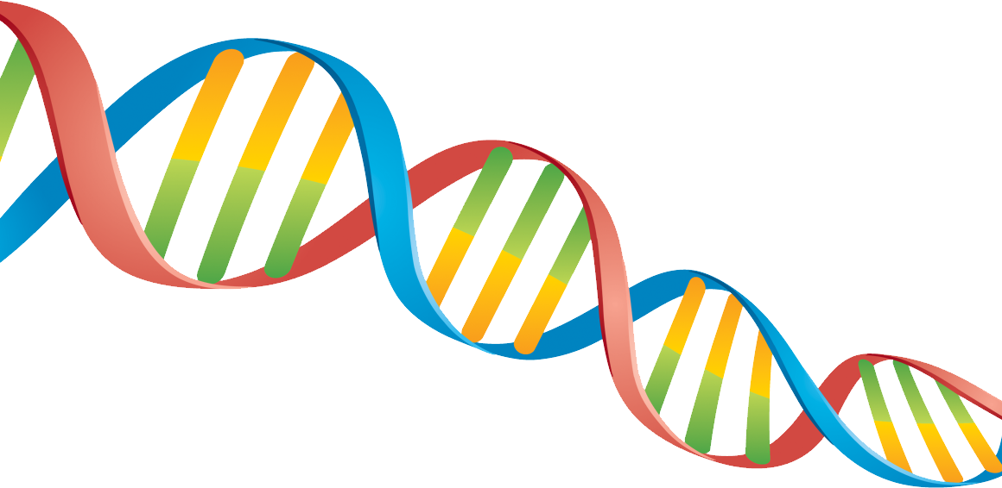
SDDEC22-12
Creating DNA from scratch for DNA-based data storage
Client: Iowa State University
Advisor: Meng Lu
https://sddec22-12.sd.ece.iastate.edu/#
Notes:
NA

Slide 2
Project Plan / Topic

Slide 3
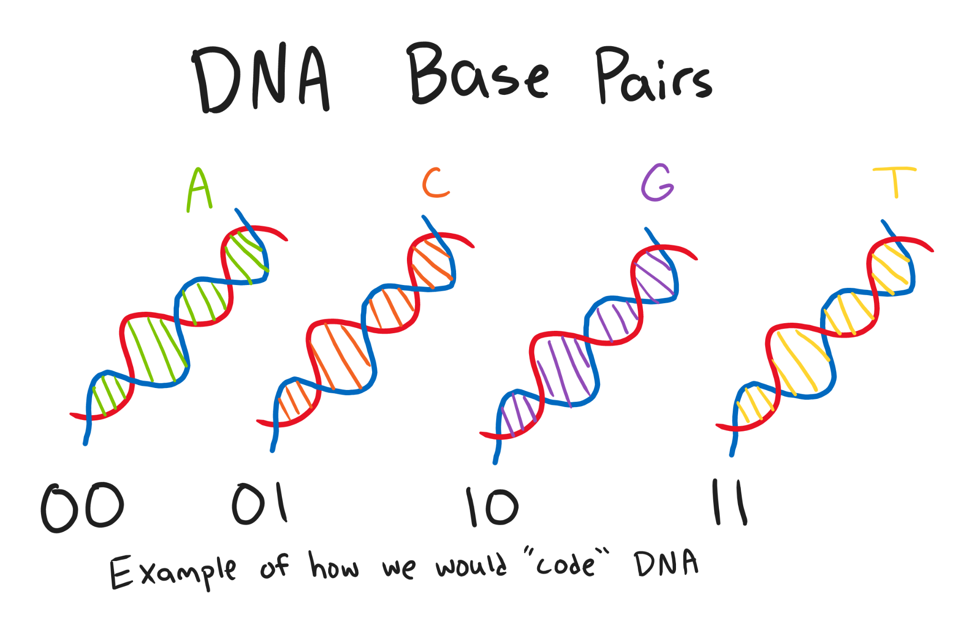
Problem Statement
To provide new medium of digital data storage
Automated design for DNA synthesis
Able to keep up with increasing demand for digital storage at an affordable prices.

Slide 4
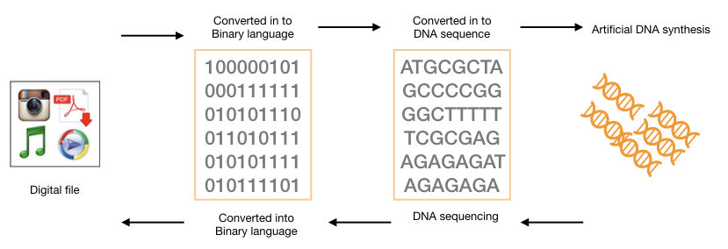
DNA Storage Medium Benefits
Stable
Large storage capacity
Extremely compact
Write and read capabilities
Ease of replication
Minimal energy and maintenance requirements

Slide 5
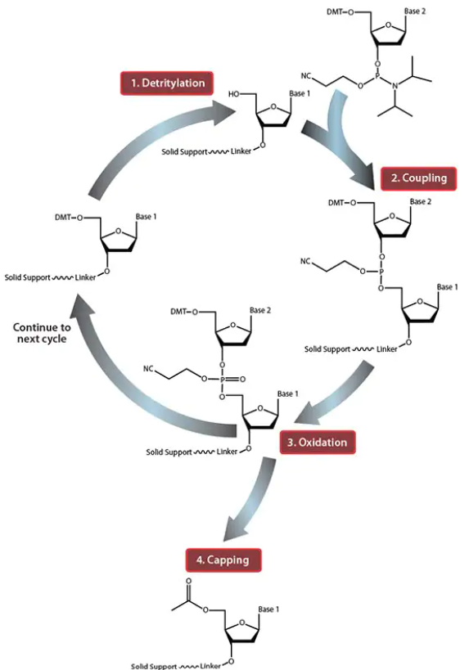
Background of DNA Synthesis
Strand is built from 3’ to 5’
Phosphoramidite Method
Detritylation: Removal of 5’ protective group
Using UV light as catalyst
Coupling: Reaction between adjacent nucleotides
Oxidation: Stabilizes the structure
Capping: Prevents unreacted nucleotides from developing further

Slide 6
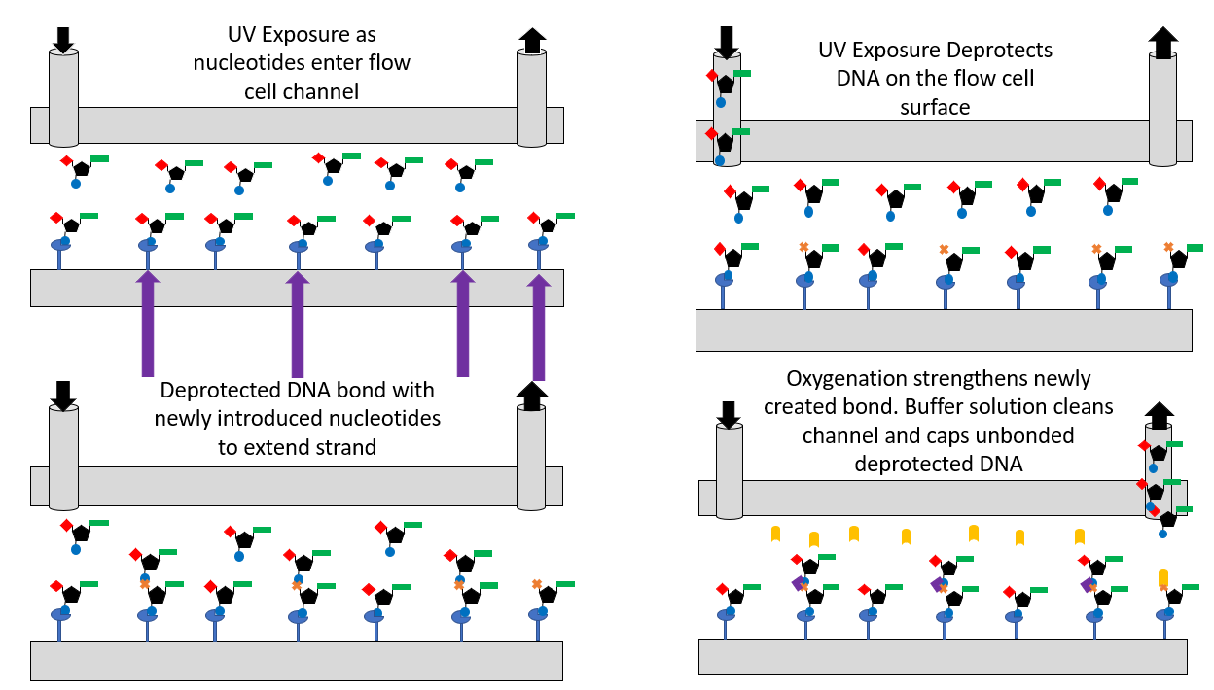
DNA Synthesis Overview

Slide 7
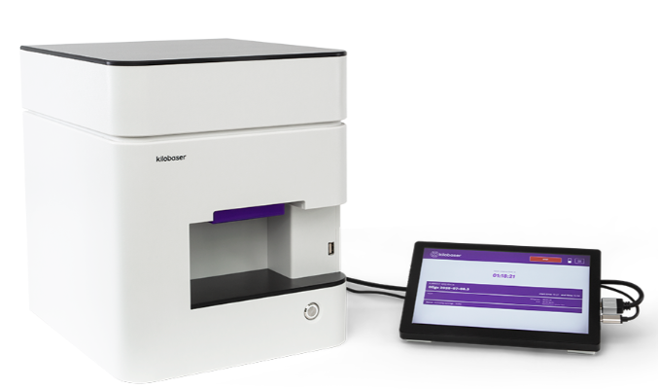
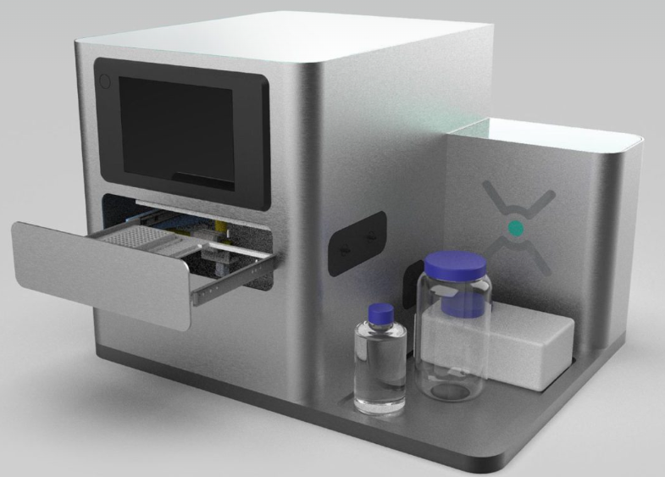
Current Market Technologies Comparison
Company | Process Time (Base pair/second) | Process Cost | Method Used
Kilobaser | 150 | $26,000 | Enzymatic Mediated
Evonetix | 30 | $12,000 | Thermal Mediated
Our Design | 60 | $5,000 | Light Mediated

Slide 8
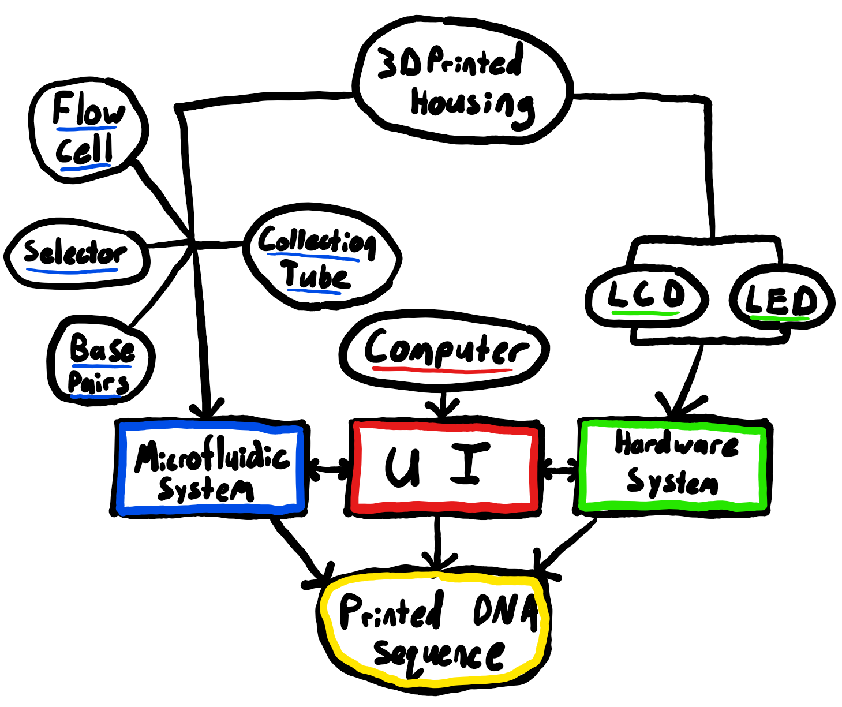
Requirements
Functional
Method to selectively pass UV light to channel (LCD)
Control of all components from single program
Capacity to perform DNA synthesis
Non-Functional
Develop new medium of data storage
Efficient and accurate system
Customizable options for user

Slide 9
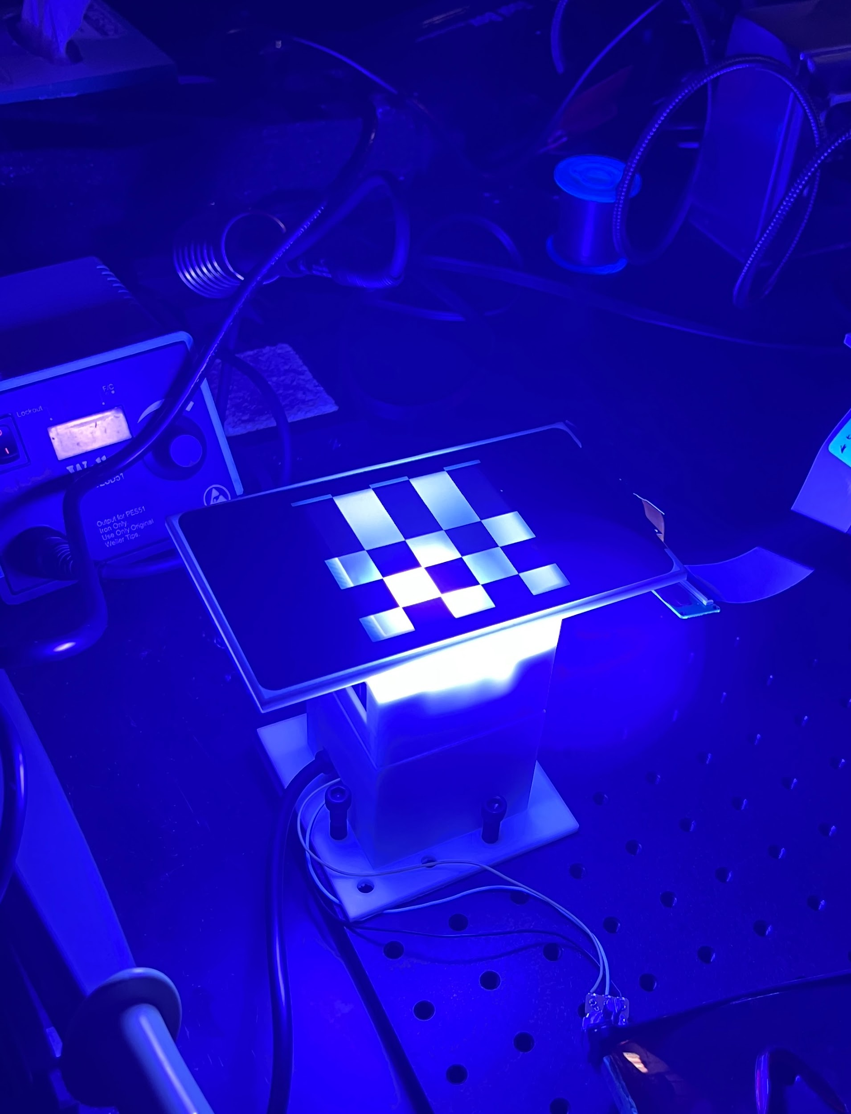
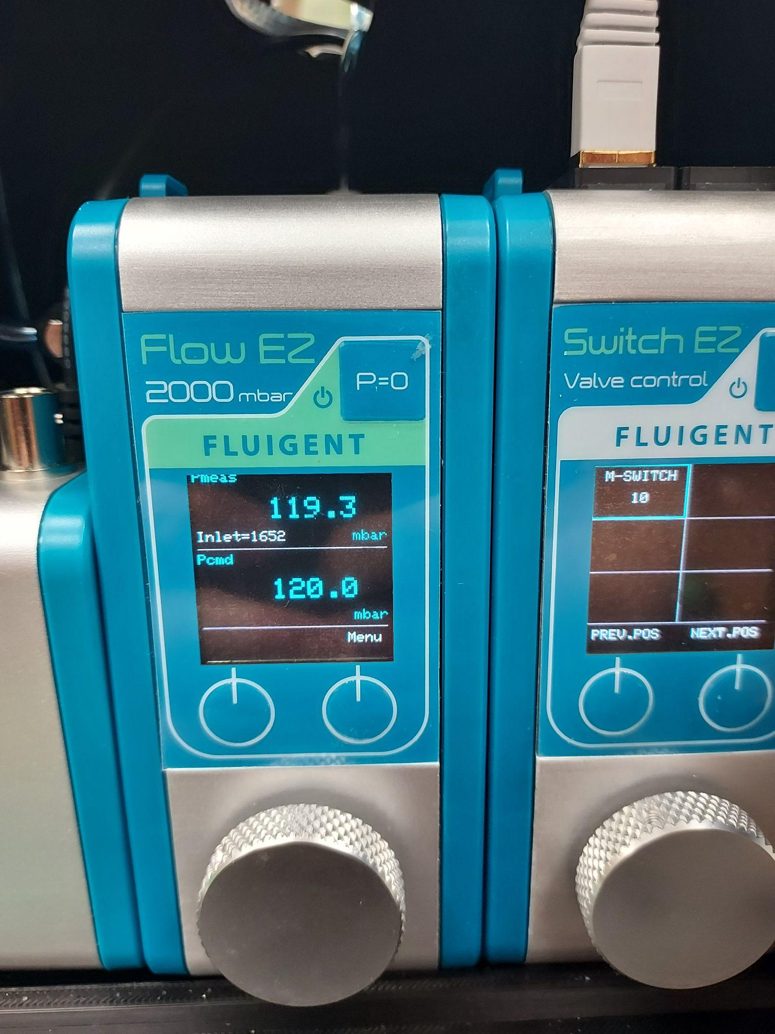
Engineering Constraints
Accuracy of DNA sequences
Control of LCD via HDMI
Ability to dynamically change matrix sizes
Pressure limitation of microfluidic system
Budget

Slide 10
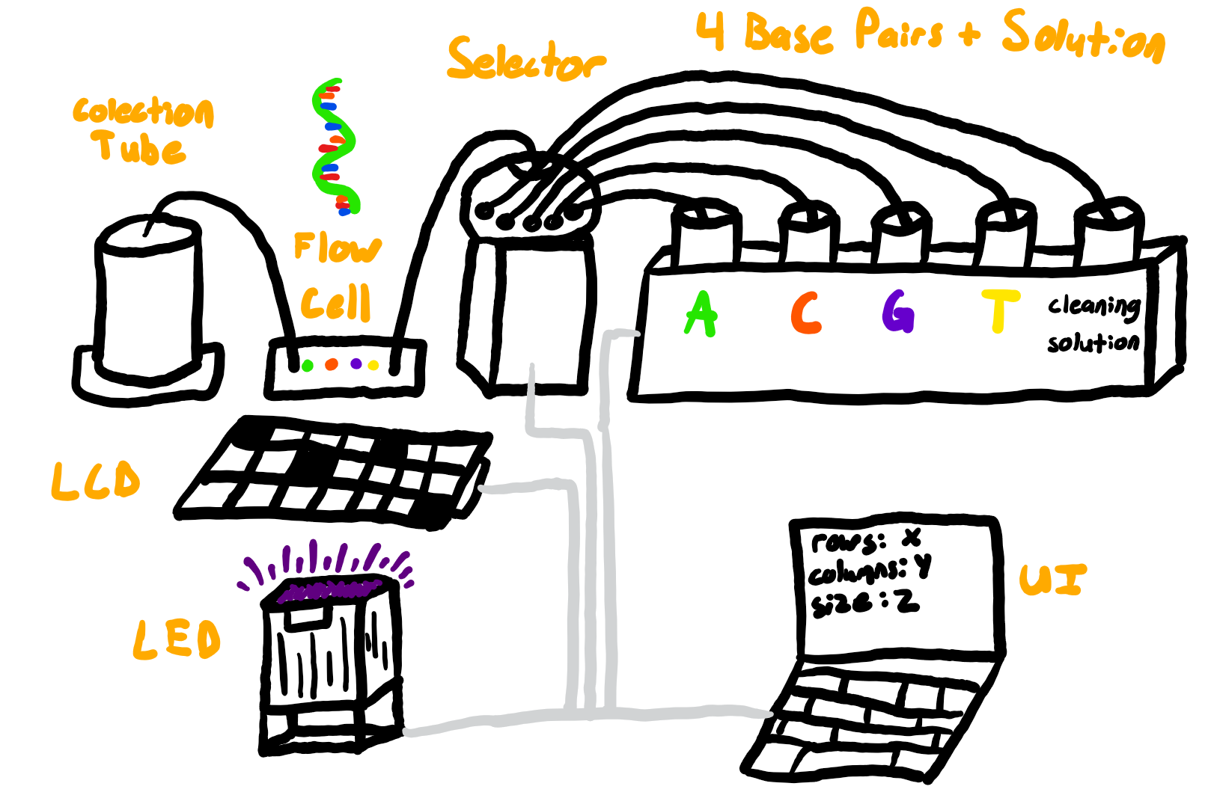
Project Topic
Notes:
BS

Slide 11
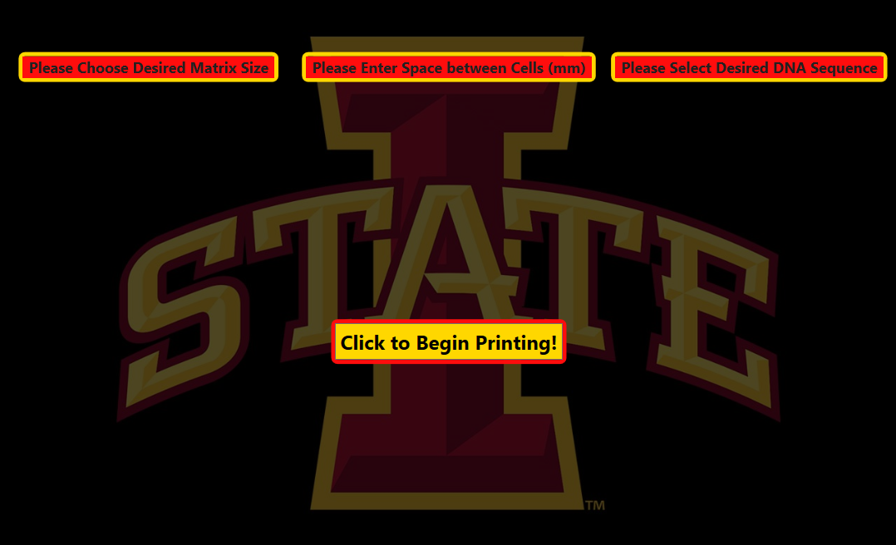
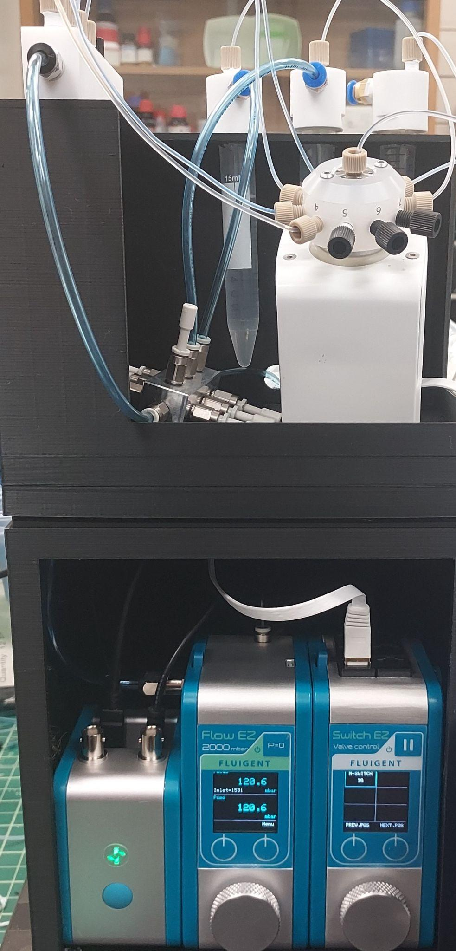
Project Design
Microfluidic System
LED/LCD
User Interface
Notes:
LH

Slide 12
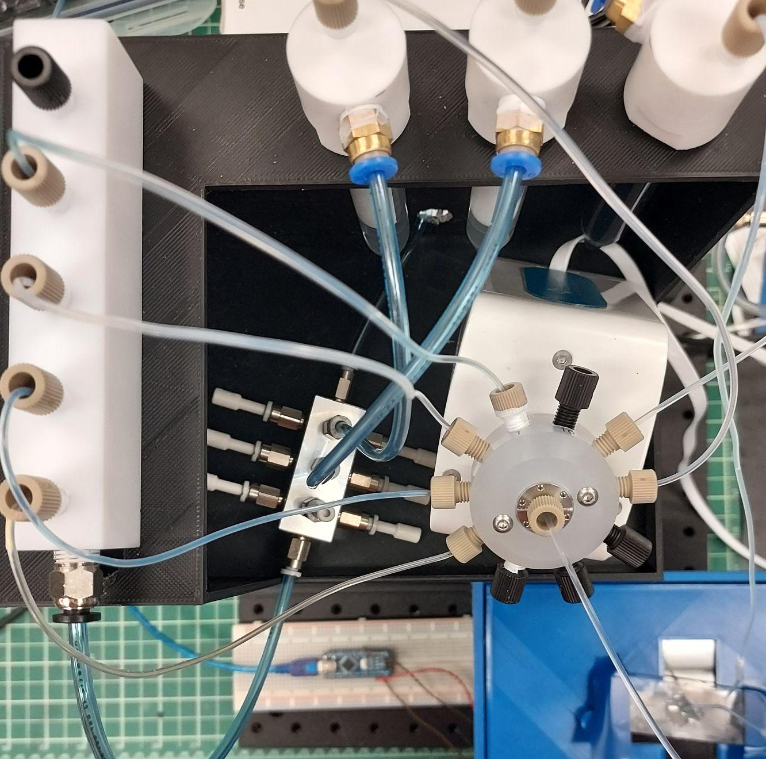
Microfluidic System
Sequentially pumps reagents to flow channel
Intermediate buffer solution to clean channel
Reactions catalyzed by UV light
Exposure time: ~25 seconds
Controlled by Fluigent SDK within UI
Notes:
LH

Slide 13
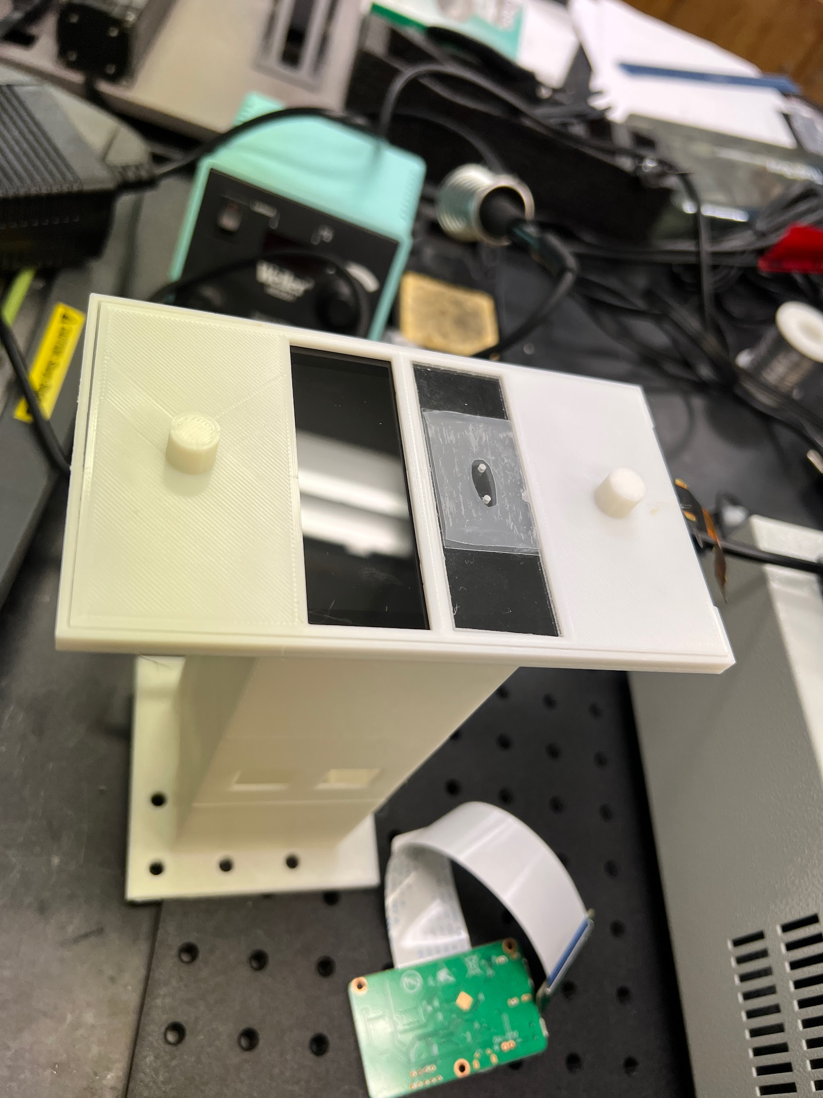
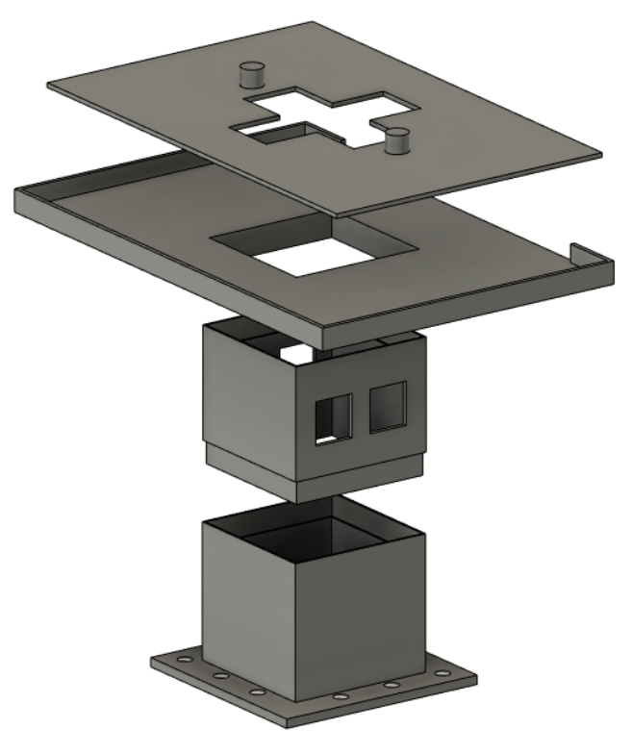
LCD/LED
Automated process to control when the LED light turns on/off
LCD screen stays on when system is on
Secure housing on the THOR board
Notes:
BS

Slide 14
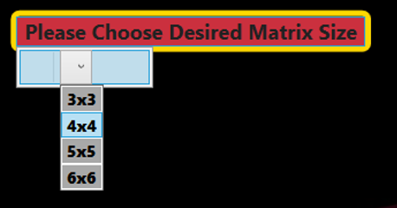
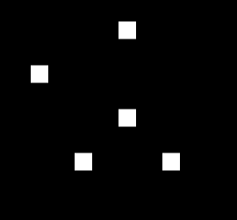
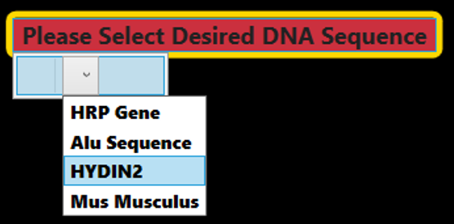
User Interface
Can be modified for user to control/automate several parts of the system
Display matrix window to LCD w/ correct dimensions
Pre-set DNA sequences
Notes:
KR

Slide 15
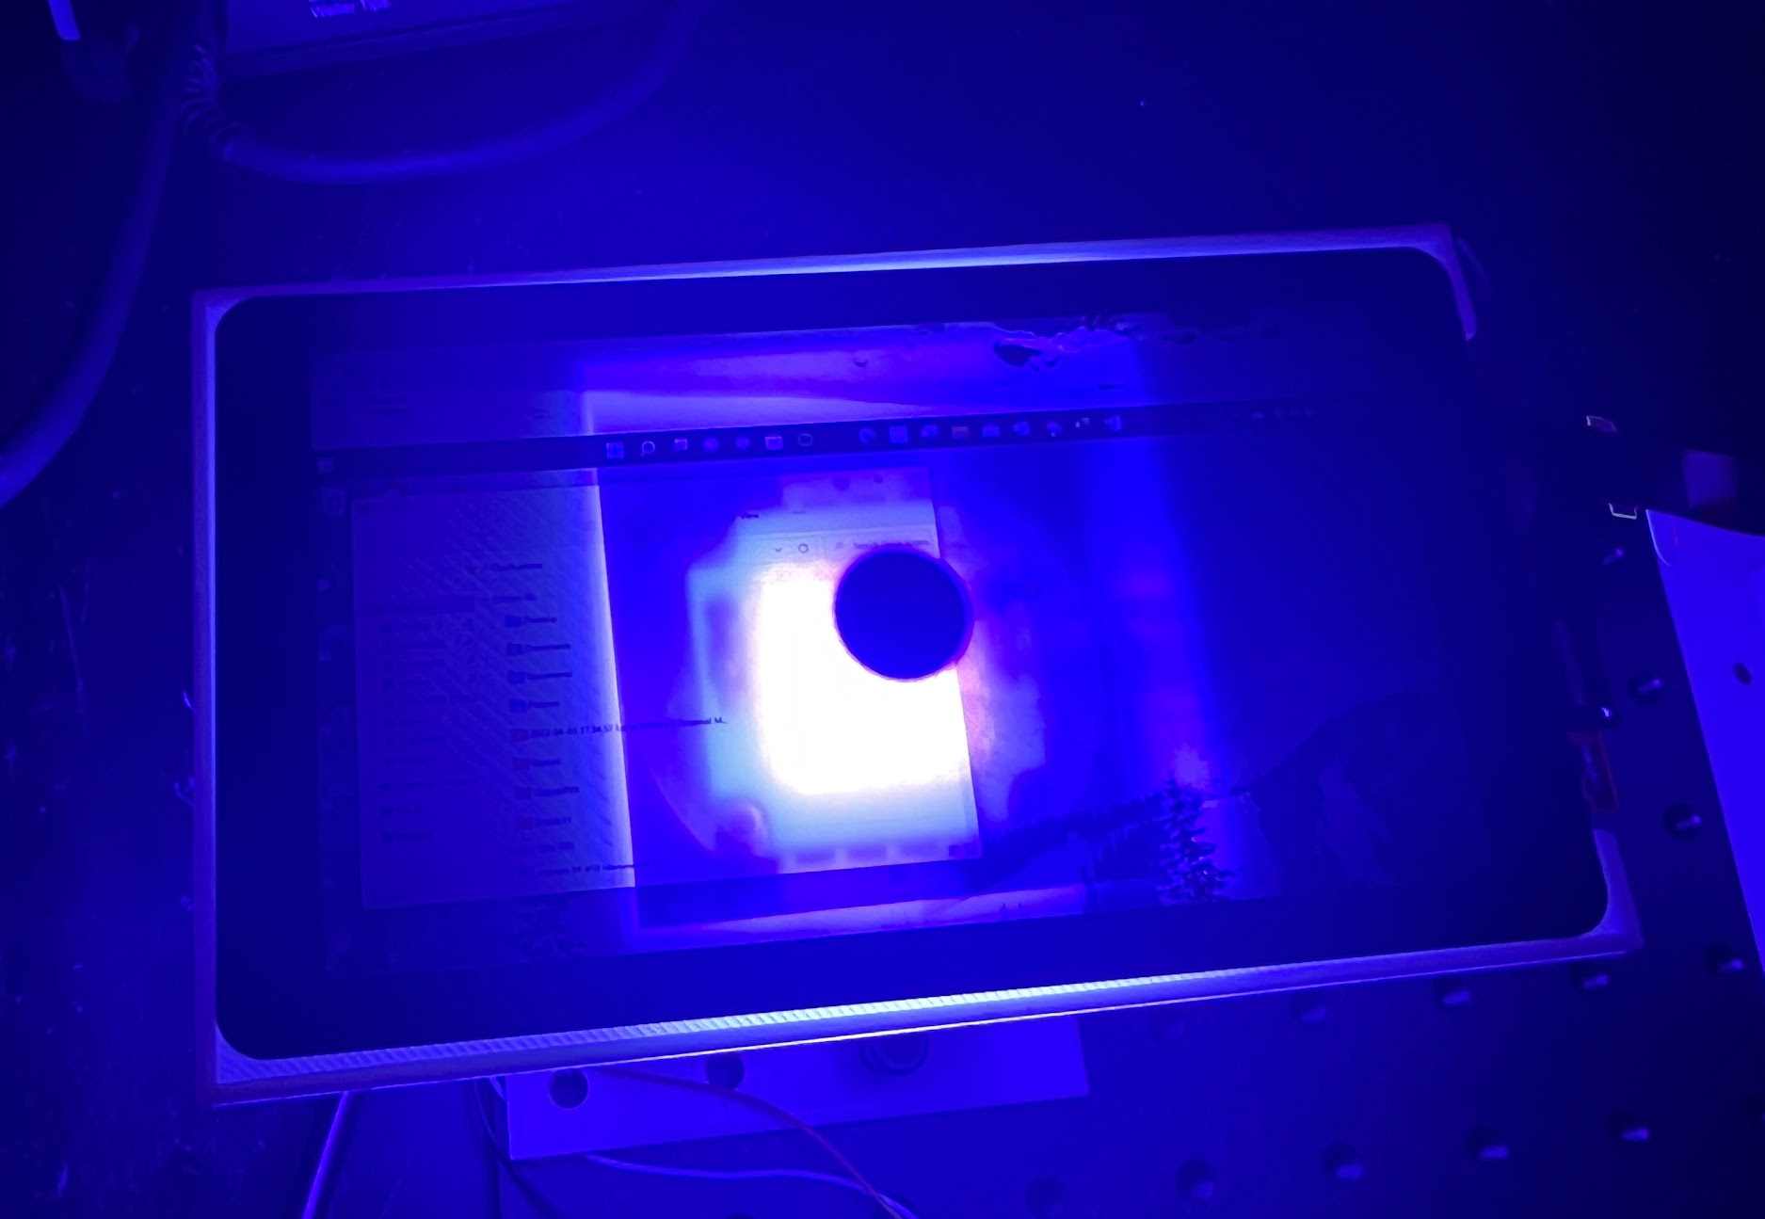
Project Challenges
Microfluidic System
Fluigent Oxygen software integration with UI
Occasional blockages in tubing (Coagulation)
Integrity under high pressure
LCD/LED
Implement Arduino code in C++
Troubleshoot issues with LCD and UV light power
Heatsink
User Interface
Varied matrix sizes in conjunction w/ preset sequences
Notes:
CL

Slide 16
Test Procedure

Slide 17
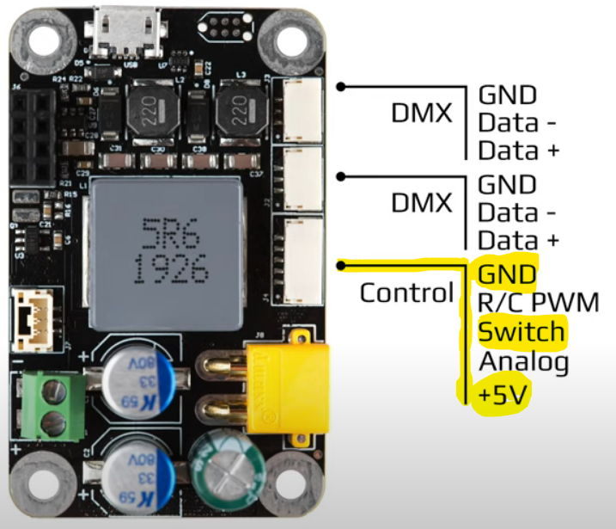
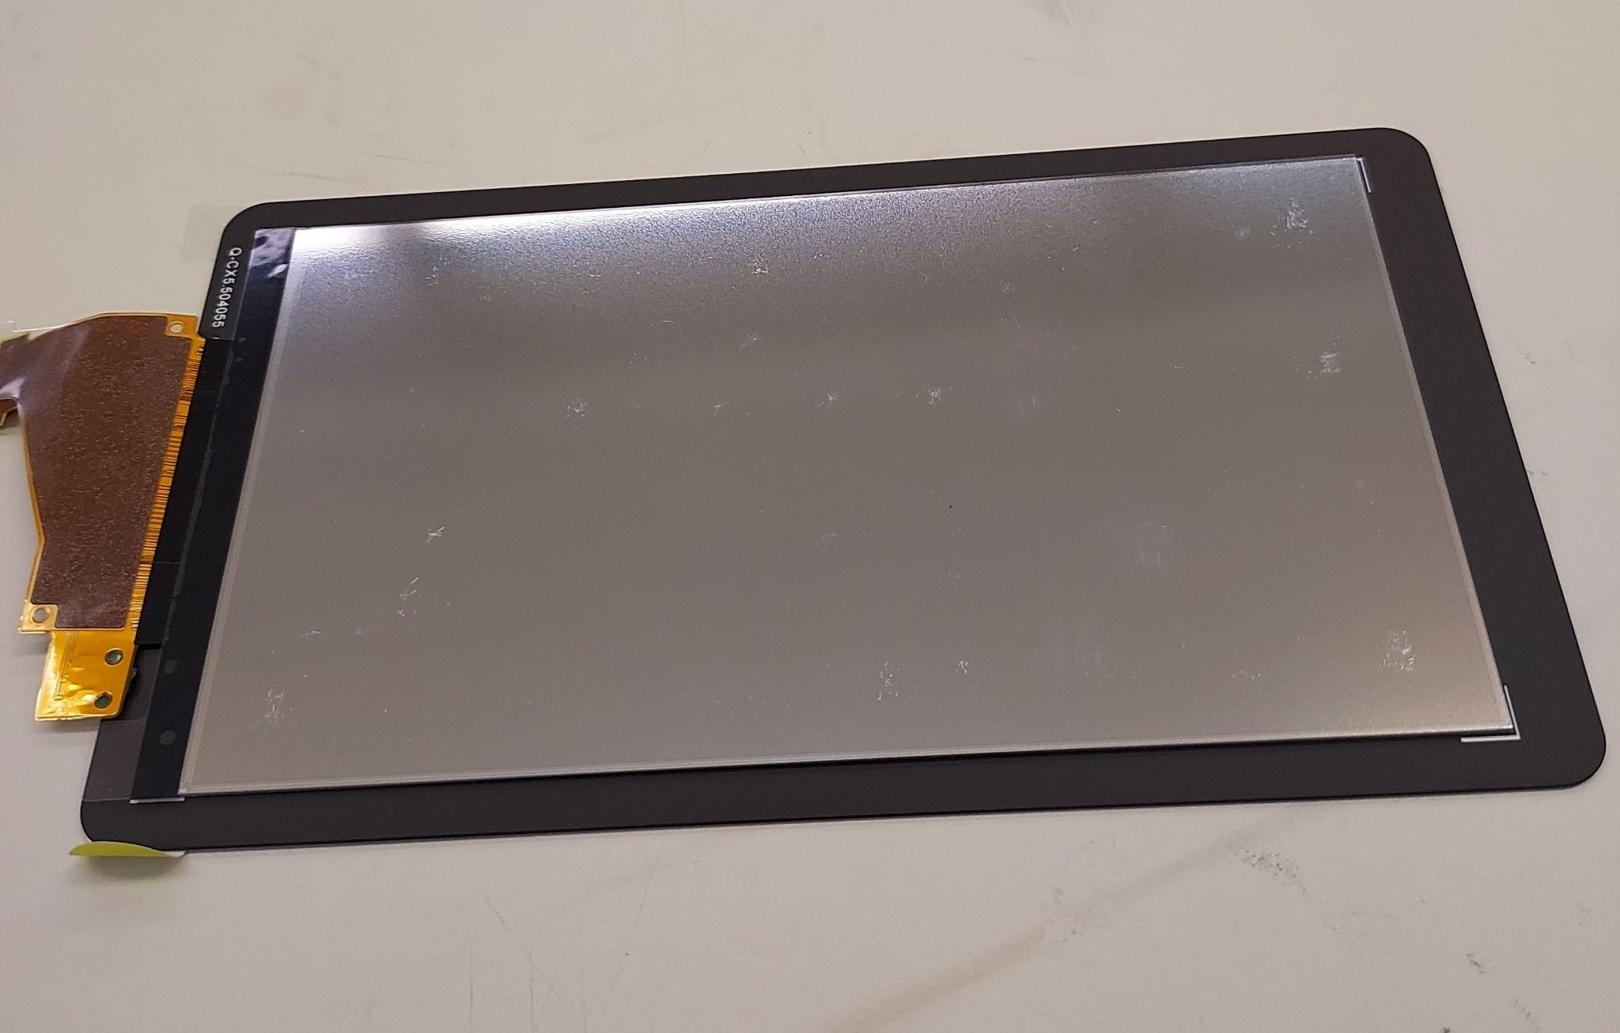
LCD/LED
Power meter for UV light power density
Heat dissipation testing
Different fluids
Various glass thicknesses
Dynamic vs. static heat dissipation
LED trigger
Tested different LCD screens
Diffusers
Resolution
Notes:
NA. LED trigger with Arduino Nano or directly via USB cable. Different LCD screens with or without diffuser and different sizes

Slide 18
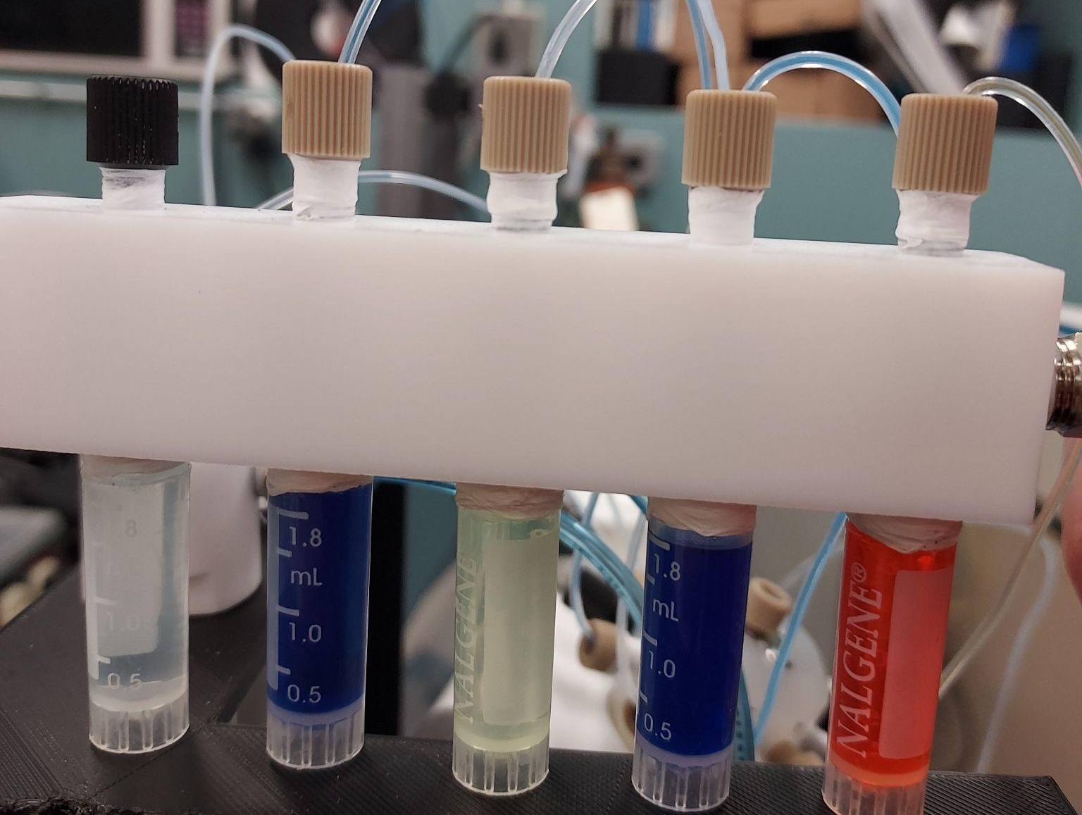
Microfluidic System
Required Measurements
Burst Pressure
Flow Rate
Exposure Time
Parameter | Measured Value
Burst Pressure | 150 mbar
Flow Rate | 33.33 μl/s
Exposure Time | 30 s
Time from Reservoir to Channel | 20 s

Slide 19
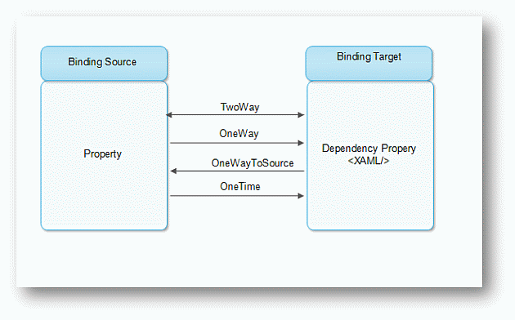
User Interface
Windows Presentation Foundation real-time updates
Matrix dimensions
Cell sizes
UI design
DNA Sequence printing
Breakpoints in Sequence split calculation
Varied delays

Slide 20
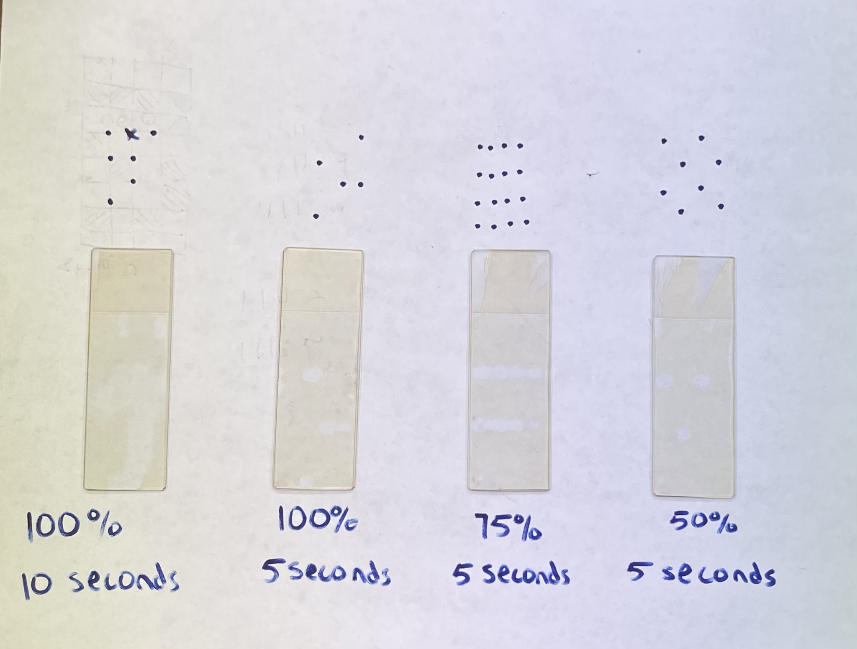
Photolithography Tests
Photoresist Test # (Left → Right) | UV Light Values
1 | 3.5 Amps @ 100%
2 | 3.5 Amps @ 100%
3 | 2.625 Amps @ 75%
4 | 1.75 Amps @ 50%

Slide 21
UI Demo

Slide 22
Display Demo

Slide 23
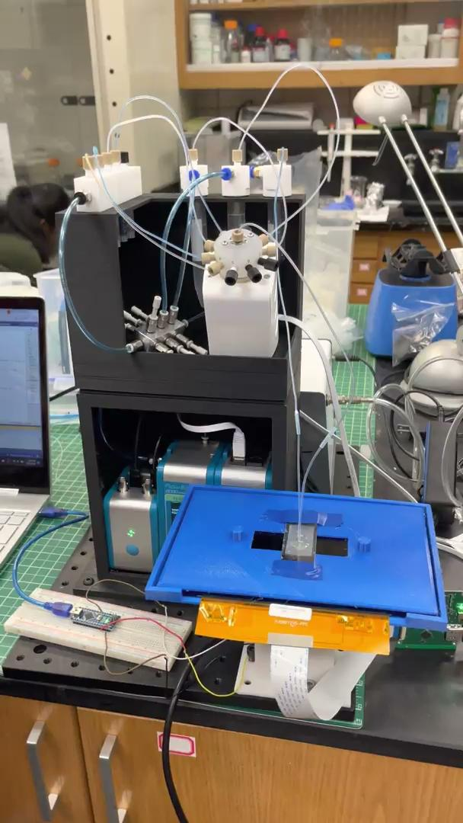
Microfluidic System Demo

Slide 24
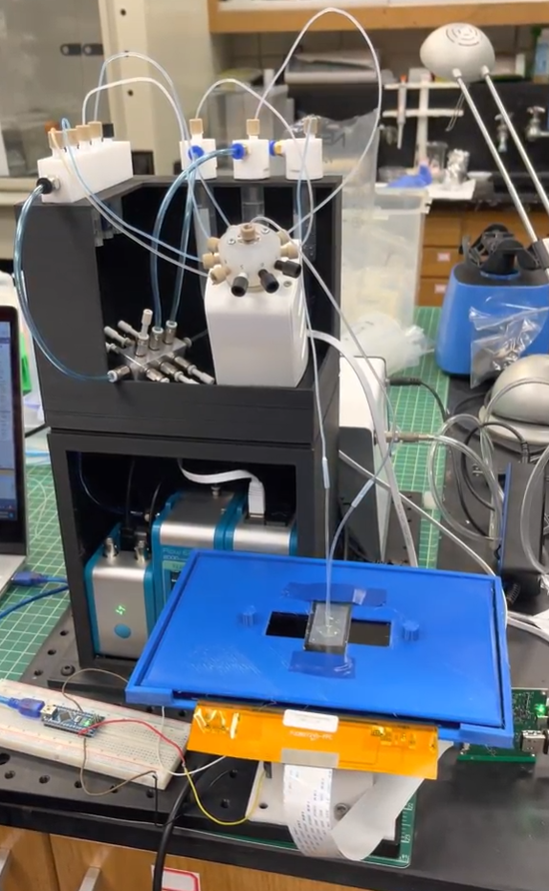
Conclusion
Skills Acquired
WPF Design practices and Data Binding
Microfluidics
DNA synthesis
3D Modeling
Thank you!
Meng Lu - Advisor
Graduate Student -Shirin Parvin
ETG - Lee Harker
Notes:
KR

Slide 25
Questions?
Notes:
CL

