Slide 1
SDDEC22-12
Project Plan
Nathan Armstrong, Lucas Heimer, Kyle Riggs, Brandon Stark, And Connor Larson
Creating DNA from scratch for DNA-based data storage

Slide 2
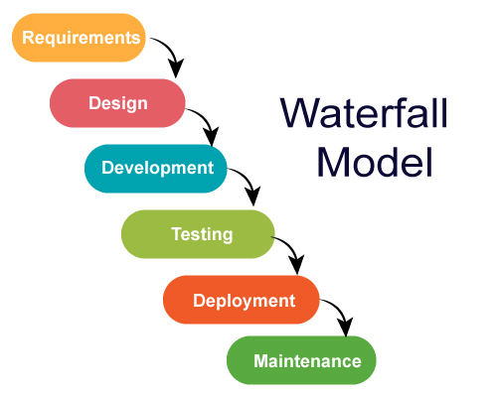
Project Management/Tracking Procedures:
Project Management
Tracking Procedures

Slide 3
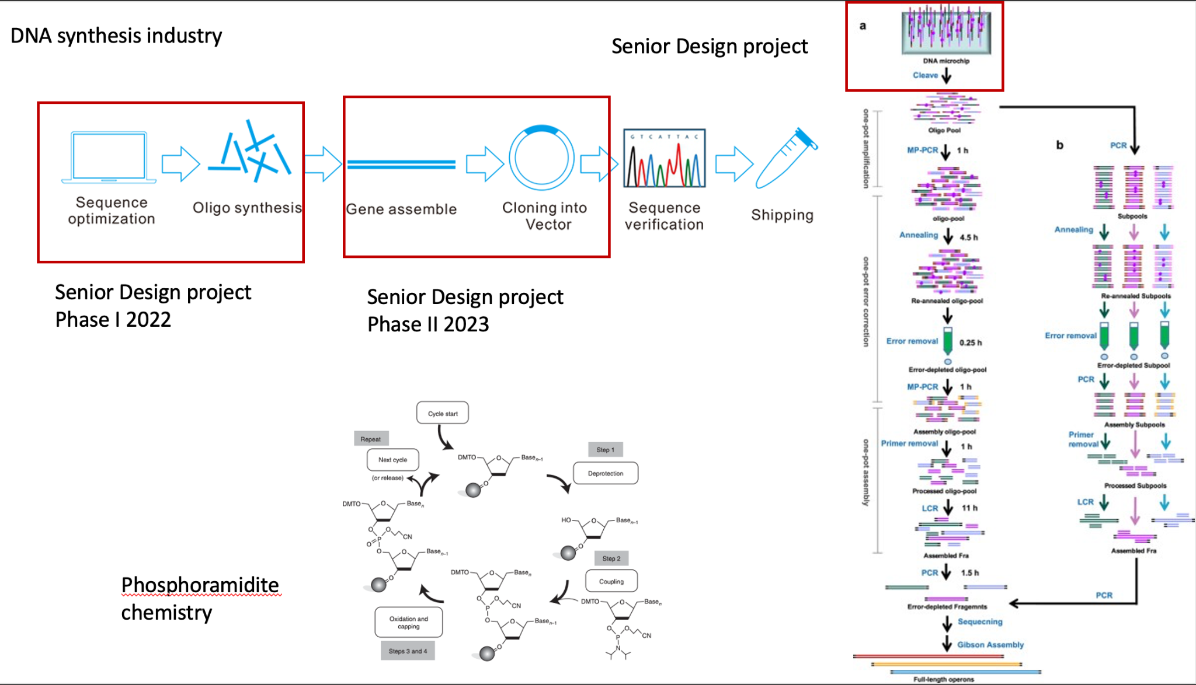
Task Decomposition:
Tasks:
Connecting to the LCD
Developing the microfluidic system
Coding a GUI
Subtasks:
Understanding biology behind DNA synthesis
Creating/coding a microarray to be displayed on the LCD
Communicate with LCD screen via created code

Slide 4
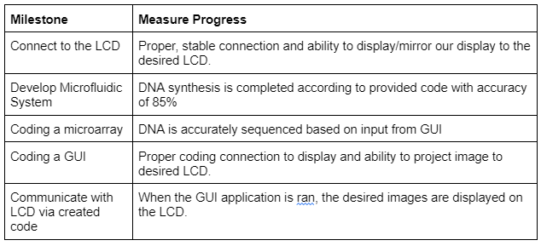
Project Proposed Milestones, Metrics, and Evaluation Criteria:

Slide 5
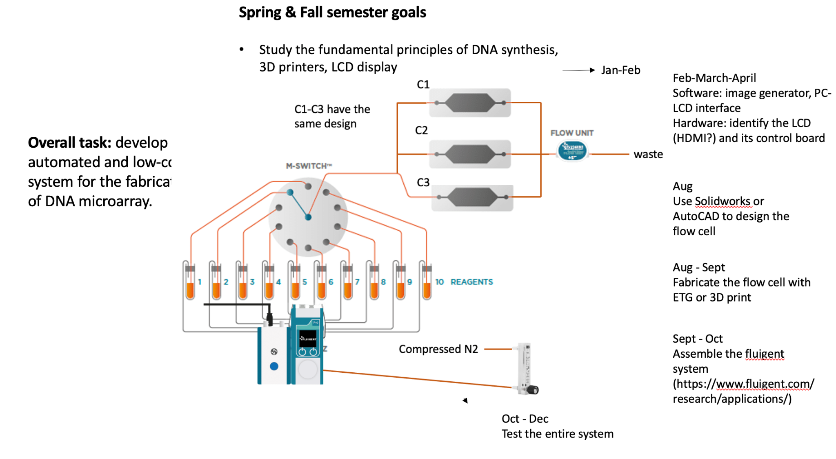
Project Timeline/Schedule:

Slide 6
Risks And Risk Management/Mitigation:
Tasks:
-Displaying to the LCD
-Developing microfluidic system
-Modifying 3D printer
-Coding GUI
-Communicating with LCD screen

Slide 7
Personnel Effort Requirements:
Tasks:
-Biology/DNA Research
-Connect/Research LCD
-Creating Microarray
-Coding GUI
-Communication between LCD and Created Code
-Developing Microfluidic System

Slide 8
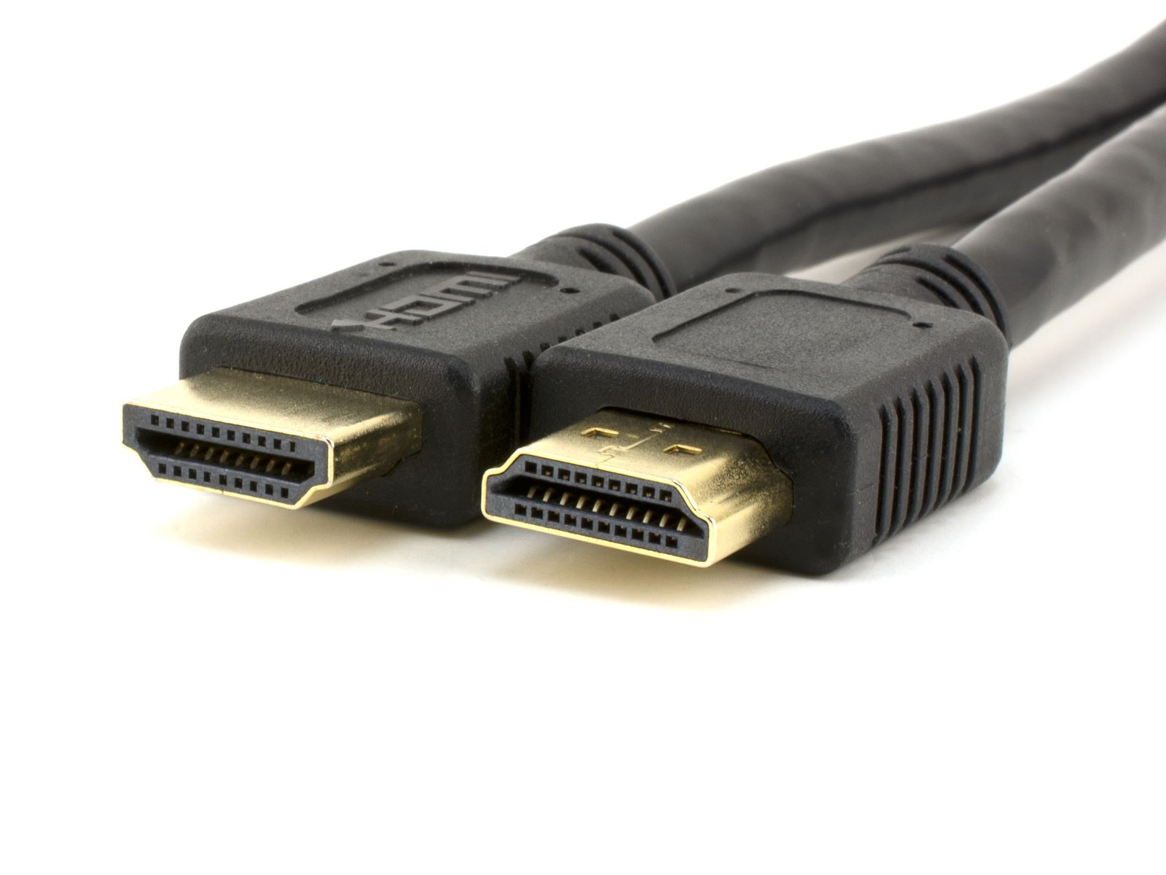
Other Resource Requirements:
-HDMI to DIPI adapter for connection between computer and LCD
-Fabrication technology for flow cell
-Various chemicals for surface functionalization of flow cell
-DNA oligomers to be used in microfluidic system

