Slide 1
SDDEC22-12
Requirements, Constraints, and Engineering Standards
Nathan Armstrong, Lucas Heimer, Kyle Riggs, Brandon Stark, And Connor Larson
Creating DNA from scratch for DNA-based data storage

Slide 2
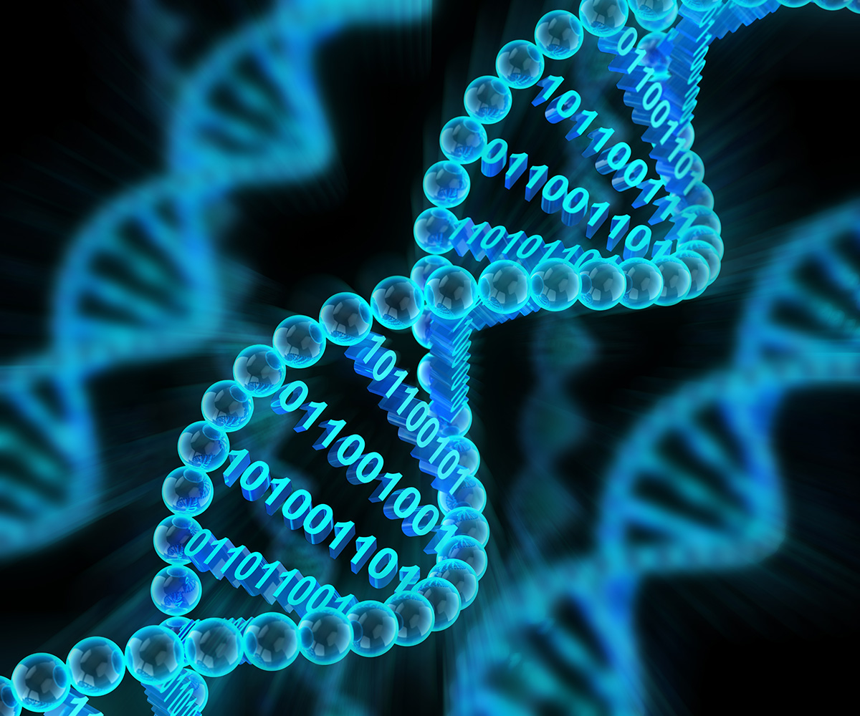
Problem Statement:
Perform DNA synthesis
Use of a modified Photon Mono 3D printer
Satisfy a new medium of digital storage
Keep up with increasing demand at an affordable price

Slide 3
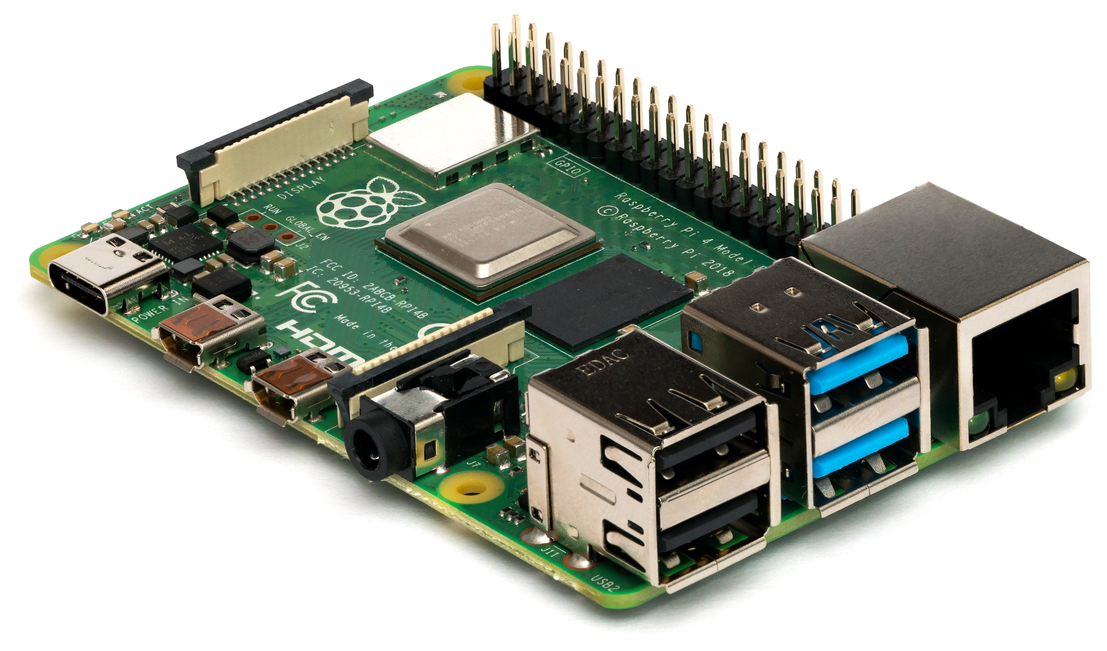
Requirement & Constraints:
Requirements:
Photon Mono 3D Printer’s LCD
Raspberry PI to control the LCD
Nucleotide fluid for microarrays
Microfluidic system to complete DNA synthesis
Constraints:
Accurately create multiple micro arrays.
Control method for Photon Mono 3D printer’s LCD.
Make a bug free, user-friendly User Interface
Use of affordable parts

Slide 4
Engineering Standards:
IEEE 802.11 - Wireless Networking “WiFi”
IEEE 260.1 - Standard Letter Symbols for Units of Measurement
IEEE 830 - Software Requirements Specifications
IEEE 1588 - Precision Time Protocol
IEEE 802.6 - Standards for information exchange between systems
IEEE 1074 - ​​Software Development Life Cycle
IEEE 1471 - Software Architecture / System Architecture

Slide 5
Intended User and Uses:
Users
Geneticists
Investors
Uses
Microarray/ User interface
Digital Data Storage
DNA Synthesis Sequencing
Disease research
Graphical User Interface

