Slide 1
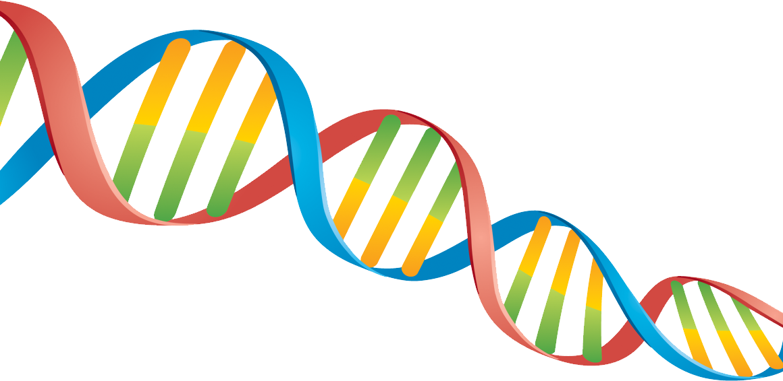
SDDEC22-12
Elevator Pitch
Nathan Armstrong, Lucas Heimer, Kyle Riggs, Brandon Stark, And Connor Larson
Creating DNA from scratch for DNA-based data storage

Slide 2
Introduction:
While there have been tremendous advances in DNA synthesis technologies, it is still challenging to create de-novo DNA sequences with a high accuracy (process of linking together)
Our goal is to print hundreds of thousands of short DNA oligomers (the building blocks for large gene segments)

Slide 3
The Problem:
New mediums of digital storage required to keep up with increasing demand
DNA synthesis is currently an expensive process

Slide 4
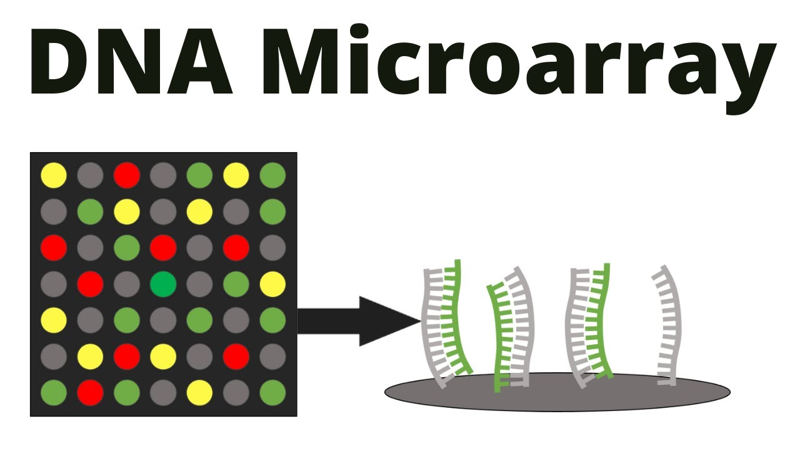
Resolution:
This resolution can be solved by modifying an off-the-shelf 3D printer
We will also develop a software controller for the 3D printer, build a microfluidic system, and test the system to create a DNA microarray

Slide 5
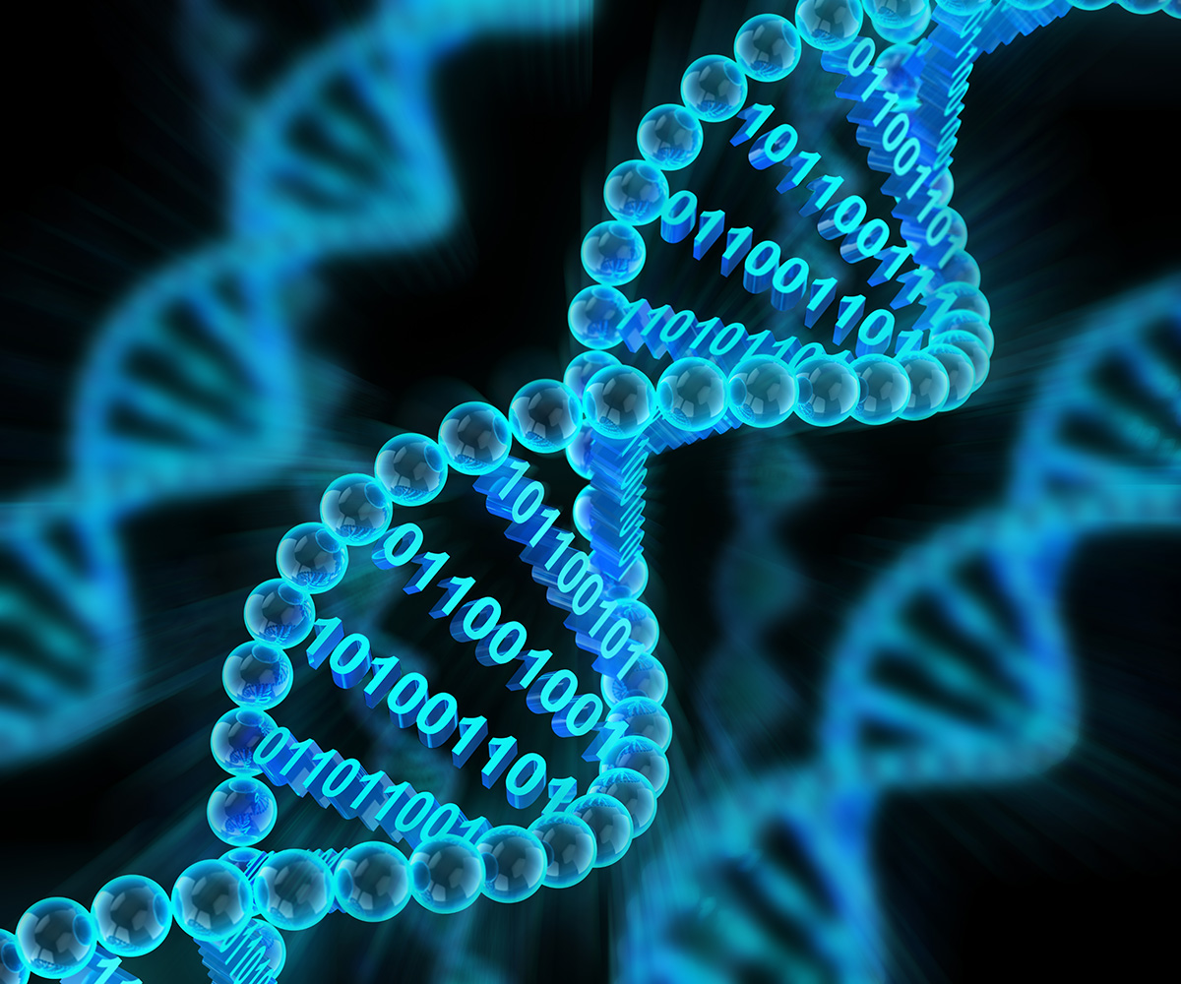
The Outcome:
The process will result in DNA which can synthesized using affordable components
The sequence of DNA oligomers will correspond to lines of digital information
The dense and stable nature of DNA provides a viable medium for long term data storage

Slide 6
Summary:
The project will yield an automated tool for creating DNA oligos and reprogramming higher organisms. The specific deliverables include:
1. A modified 3D printer that can create DNA microarrays;
2. A user interface that controls the 3D printer.

